Slide 1
St. Saviour’s Church of England Junior School
P.E.S.E.
Procedure for Entrance into Secondary Education

Slide 2
Tonight’s meeting
Types of Secondary schools
PESE process
PESE Tests: Kent Test
Secondary Common Application Form

Slide 3
Milestone
Leaving Primary School
One class, different Learning Groups
Smaller environment
Entering Secondary School
Lots of teachers
Different classes/groups
Large environment

Slide 4
The years ahead?
Secondary Selection Process
Key Stage 2 SATs
Move to secondary school
GCSEs
A Levels / IB
Many other qualifications
University
College
Work
Not necessarily in that order

Slide 5
The Curriculum
All primary schools follow programmes of study from National Curriculum
All secondary schools follow programmes of study from National Curriculum
All secondary schools follow similar syllabi for GCSE but may offer a specialism

Slide 6
Types of schools!
Grammar
More able
25%
Fast pace
Need to keep up
Wide Ability
Mixed ability
Most children
Slower pace if necessary
Independent Schools
Special Schools

Slide 7

No Door is Shut
Similar Opportunities
Similar Curriculum
Grasp opportunities

Slide 8
Schools in Thanet
Wide Ability
Charles Dickens
Harbour Academy
St.George’s *
Hartsdown
Ursuline *
King Ethelbert’s
Sandwich Tech
* = Supp form required
Grammar
Chatham and Clarendon House
Dane Court
Sir Roger Manwood

Slide 9
Which school for my child?
Academic Ability: Kent Test
Grammar or wide ability
Distance from home
Travel implications
Religious preference
Practising Christian
Other
School ethos
Clubs, activities, family connections etc
Main considerations
Every school has an Admissions Criteria

Slide 10
Is my child suited to grammar school?
Current setting / tutoring
National curriculum levels
Reading / homework habits
Attitude to learning, aspiration
Family attitude to learning and willingness to support
Resilience, how does your child cope with a challenge / high workload?

Slide 11
The Kent Test
How many children are selected for Grammar School each year?
25% of the Year 6 children in Kent will be selected for Grammar school.
The pass rate in Thanet was 12%, East Kent 14%
23% of pupils are selected using the test.
The other 2% are selected from appeals.
10 + 10 HT appeals + parent appeals pupils in our current Year 6 cohort will attend a grammar school in September.

Slide 12
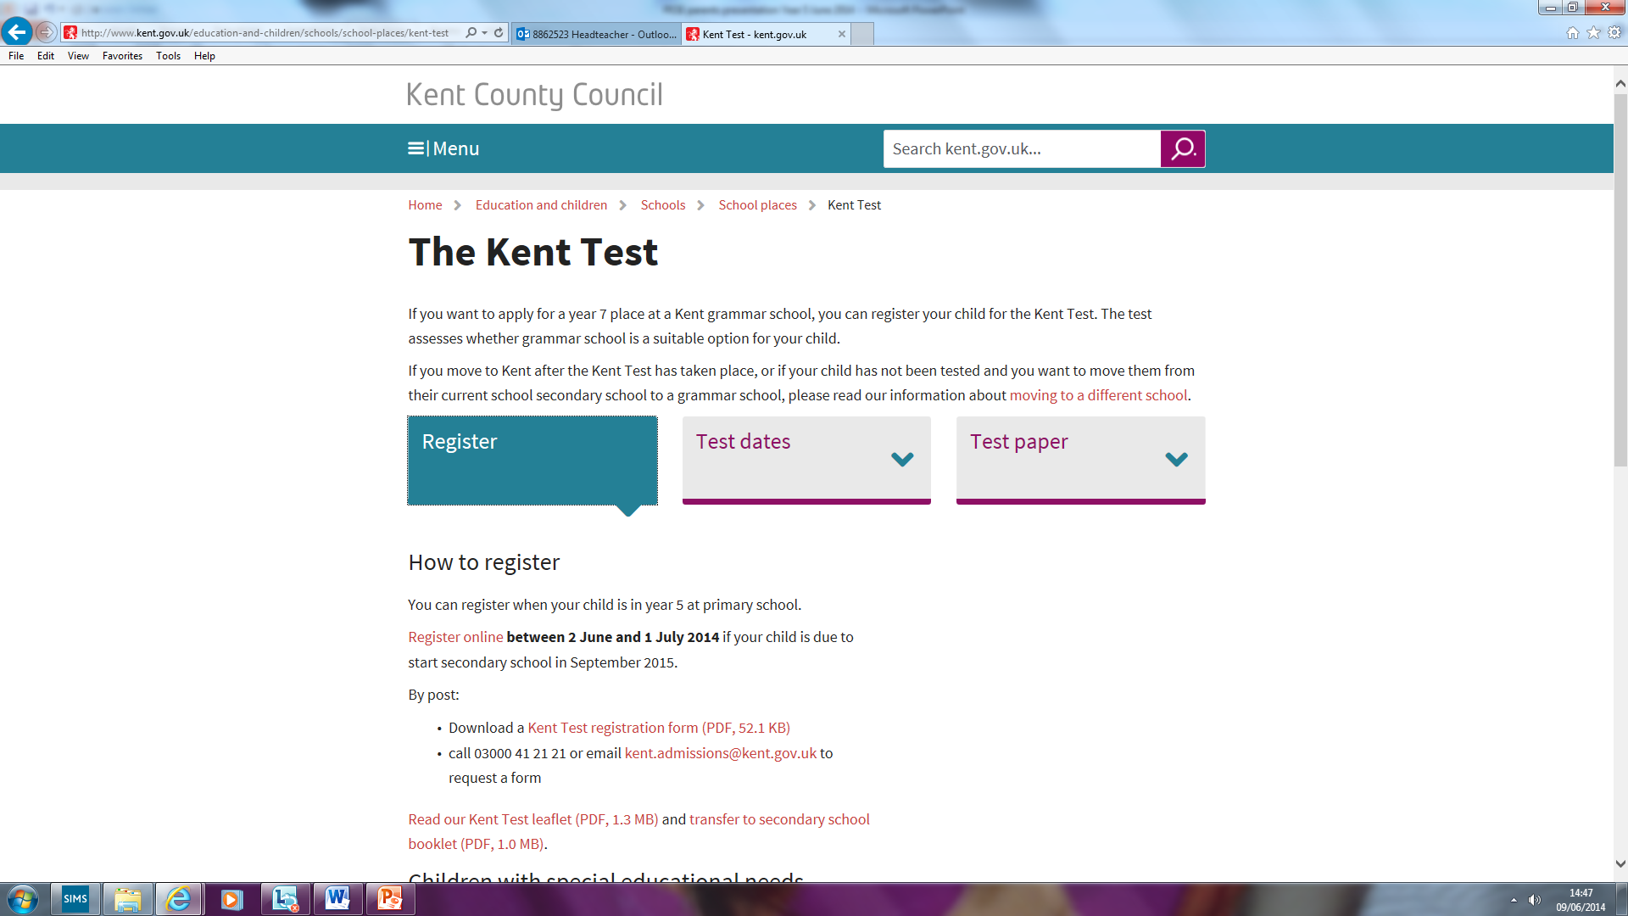
The Kent Test

Slide 13
The Kent Test
12th September 2019
Test 1: Multiple choice English and Maths paper with a separate answer sheet.
1 hour test
2 sections:
English 5 min practice + 25 min test
Maths 5 min practice + 25 min test
The English section will involve a comprehension exercise as well as some additional questions drawn from a set designed to test literacy skills.

Slide 14
The Kent Test
Test 2: Multiple Choice reasoning paper.
1 hour test, including the practice sections and questions.
Verbal Reasoning section & then a Non-Verbal reasoning section of roughly the same length
Non-verbal reasoning will be split into four sections, administered and timed individually (as in the previous tests).

Slide 15
The Kent Test
Plus: A writing exercise
This will not be marked but may be used by the ‘Headteacher Appeal’ panel to review borderline cases.
40 minutes will be allowed for the writing task, including 10 minutes planning time.

Slide 16
How is the decision made?
Based on test results (107+, 323+)
Tests are marked & results are standardised.
Age is taken into consideration/youngest not disadvantaged
Assessment results to schools
Headteacher appeal if necessary
Test scores
School work/reports
Writing task
Headteacher comments
Parents informed of decision 17th October

Slide 17
The Kent Test
If you want your child to sit the tests – we would advise you to practise!
NEW Test introduced in 2014 … if you feel your child has the ability to achieve in a Grammar School setting then prepare them for the tests they will need to take to get there!
Special arrangements deadline 10th July

Slide 18
The Kent Test:
Key Dates
Register online 3rd June to 3rd July if you wish for your child to sit the Kent Test (to assess suitability for grammar school place)
If in doubt, register – can withdraw on the day.
Your child’s Y5 teachers will give an opinion as to which type of education your child is best suited to. NVR test results and SATs scores are good indicators.
Testing –12th Sept 2019
17th October – Parents notified of assessment results (by email by 4pm…ish)
http://www.kent.gov.uk/education-and-children/schools/school-places/kent-test

Slide 19
Transition to Secondary School - Key Dates:
17th October – Parents notified of Kent test results (by email)
Complete ‘Secondary Common Application Form’ (SCAF) by 31st October 2019. If you think you may want to make a parental appeal, name the grammar schools you wish to appeal for on your form (not necessarily 1st and 2nd)
Parents will be invited to express four preferences in priority order
Some schools may ask parents to provide additional information on a supplementary form; this must be returned to the school you are applying to. This is not an application form; the only valid application form is the SCAF

Slide 20
Secondary Common Application Form
Place schools in order of preference
Choose at least one grammar school if you want your child to take the Kent Test
Little point in putting in a school first if you are outside the catchment area or do not fulfil religious requirements
Be aware that KES catchment area is relatively small

Slide 21
LA system for managing the allocation of places:
The LA will let each secondary school know the names of children who appear on the SCAF, but schools don’t know whether they are 1st, 2nd ,3rd or 4th choice.
The school then rank the children in order of their admissions criteria.
If, for example, your child has Dane Court as a first choice on the CAF and you fulfil the admissions criteria (probably distance) your child will be offered a place there. If your child is not offered a place, because of the oversubscriptions criteria, a place will be offered at another school listed on your CAF…

Slide 22
You may be thinking, ‘we don’t want our child to go to a grammar school but we would like him or her to ‘take the 11+’ …. If you feel that your child will cope with this, and also cope with managing an unsuccessful result, go ahead… if you think your child would be upset by an unsuccessful outcome… don’t!
The booklet will explain the waiting list and appeals processes – the appropriate forms will be sent to you with the allocation of places letter, for you to return to the authority.
You can ONLY appeal for a place at any school that you named on your form, wherever you ranked it on the CAF.
If your child enters the testing procedure and doesn't gain a positive result… as well as naming NON- SELECTIVE schools on your form, you can put grammar schools on the CAF and appeal for a place at the grammar schools.

Slide 23
What if I disagree with the Kent Test assessment or secondary school given?
Talk with Headteacher
Decide to appeal or not
Parental Appeal process
2nd March 2020 school offers
No parental appeal can take place before March

Slide 24
Parental / Carer Appeals
The process is explained in the pack you will receive with school offer (2nd March) letters. Accept / refuse offer
Parent appeals should focus on:
Academic level of child
Reasons why scores do not reflect actual or current ability (significant family trauma around time of test, illness etc.)
Supporting letter from school with current / projected grades and attitude to learning (I can’t lie!)
Deadline, end of March

Slide 25
Finally…
All schools provide similar opportunities
Make the most of them
Bottom of the heap or top of the pile?
You don’t need to go to grammar school to achieve high academic success
Many routes to same destination
Parent’s decision
Supportive family

Slide 26
Key Dates
Parents will need to register by 3rd July if you wish for your child to take part in the testing process, if they don’t take part in the testing process then you will not be able to name a Grammar School as one of your preferences
Year 5 / SLT teachers are available to advise
Testing –12th September
17th October – Parents notified of Kent Test Assessment results (by email)
The SCAF should be completed online (let us know please!) or returned to school office by 31st October
2nd March 2018 all parents will be notified of the school allocated for their child (by email)

Slide 27
Questions?

