Slide 1


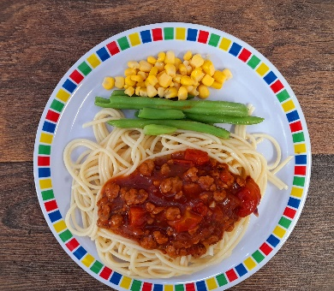




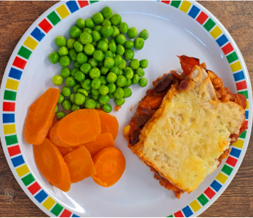
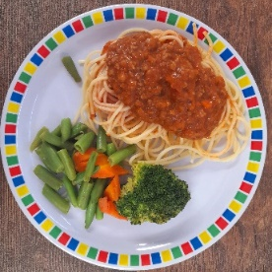
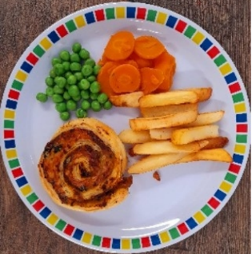
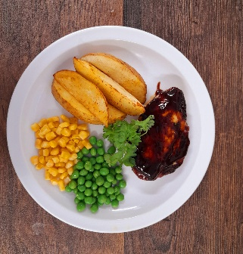
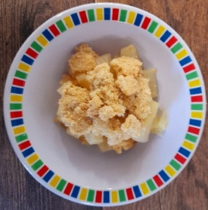



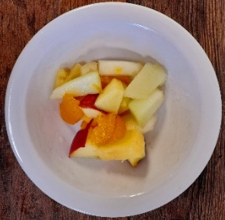
Spring Summer 2024
Cheese and Tomato Pizza with Pasta Salad
Penne Bolognaise
Sausages, Roast Potatoes & Gravy
Greek Chicken Pitta
Fishfingers with Chips & Tomato Sauce
Vegetable Stack with Rice
Vegan Penne Bolognaise
Vegan Sausages, Roast Potatoes & Gravy
Cheese Whirl
BBQ Quorn with Chips
Apple Crumble with Ice Cream
Vanilla Shortbread
NEW Berry Mousse
Iced Vanilla Sponge
Fresh Fruit

Slide 2

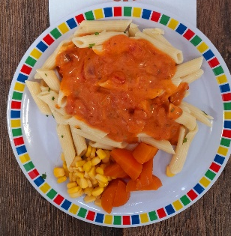
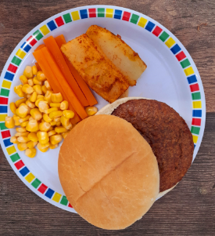



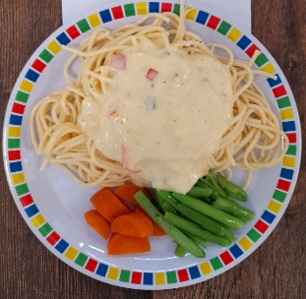
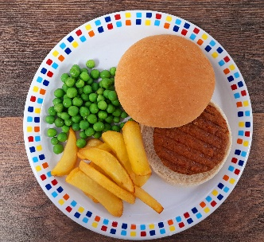

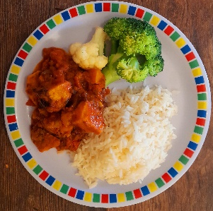





Spring Summer 2024
Pasta Kitchen
Tomato Pasta
Beef Burger with Potato Wedges & Tomato Sauce
Roast Chicken, Stuffing & Roast Potatoes
Beef Lasagne with Garlic Bread
Fishfingers with Chips & Tomato Sauce
Vegetarian Carbonara Pasta
Vegan Burger with Potato Wedges & Tomato Sauce
Vegetable Wellington, Stuffing & Roast Potatoes
Vegetable Curry with Rice
Mexican Bean Sausage Roll with Chips and Tomato Sauce
NEW Chocolate Brownie
NEW Iced Biscuit
Fruit Jelly with Mandarins
Oaty Cookie
Fresh Fruit

Slide 3


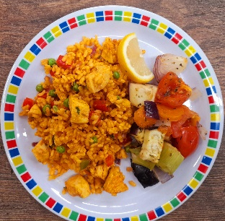
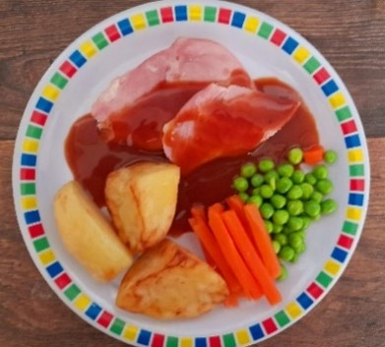
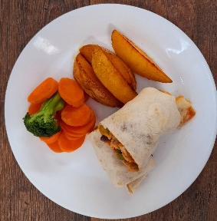

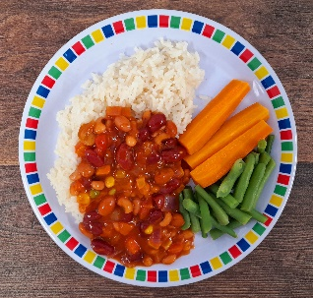

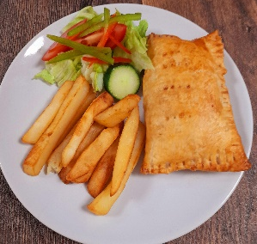
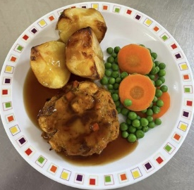




Spring Summer 2024
Macaroni Cheese
Chicken Paella with Patatas Bravas
Roast Gammon, New Potatoes or & Gravy
NEW Chicken Fajitas
with Rice
Fishfingers with Chips & Tomato Sauce
Vegan Chilli with Rice
Veggie Wrap with Patatas Bravas
Parsnip & Sweet Potato Loaf, New Potatoes & Gravy
Bean & Cheese Pasty with Chips
Vegetable Lasagne
Chocolate Shortbread
Summer Lemon Cake
Peaches & Ice Cream
Syrup Snap Biscuit
Fresh Fruit

