Slide 1
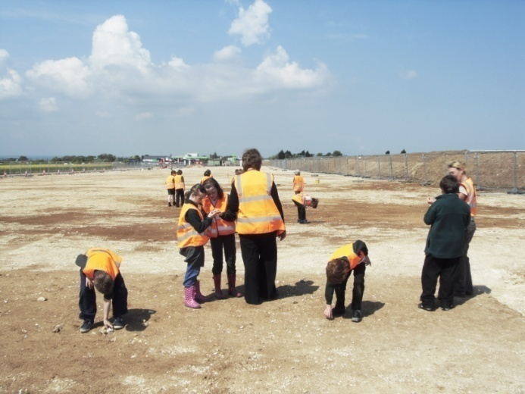
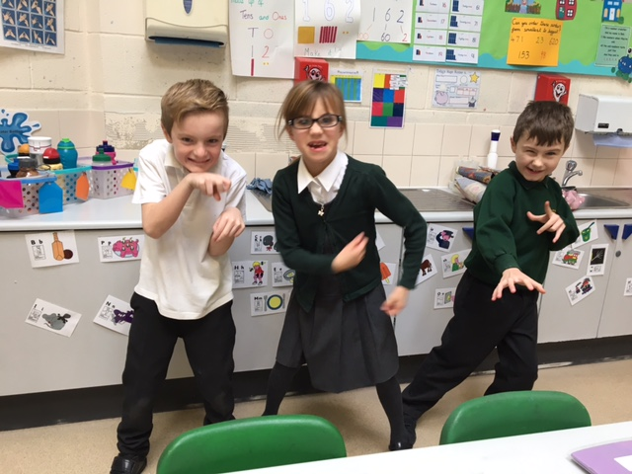
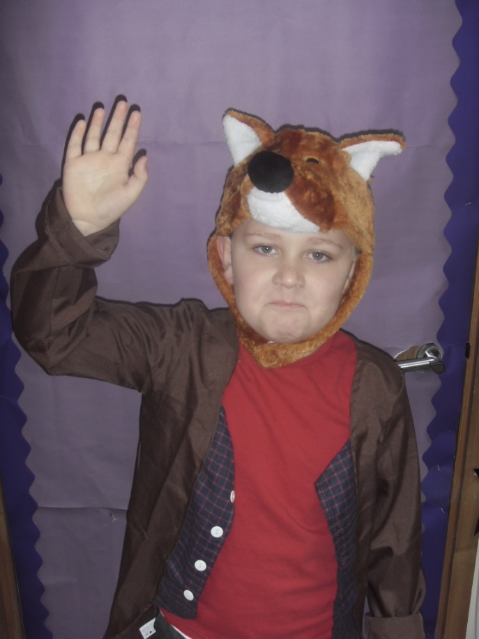
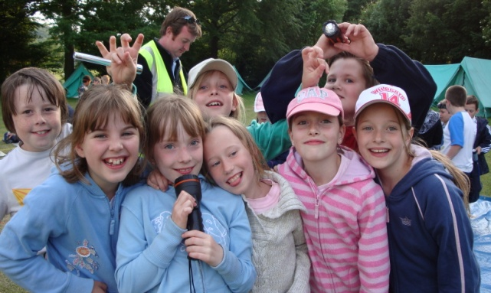
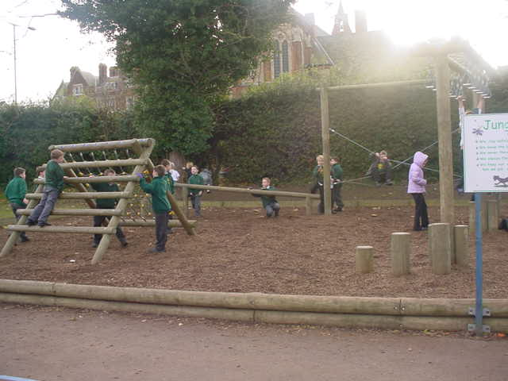
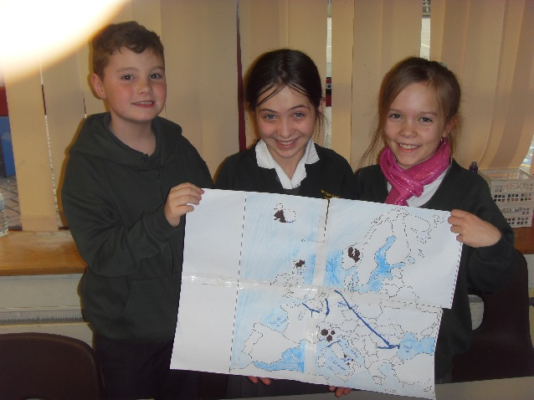
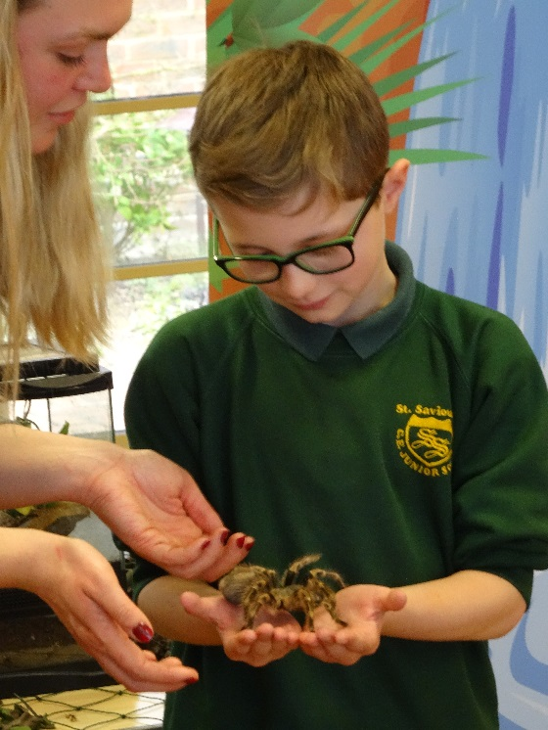
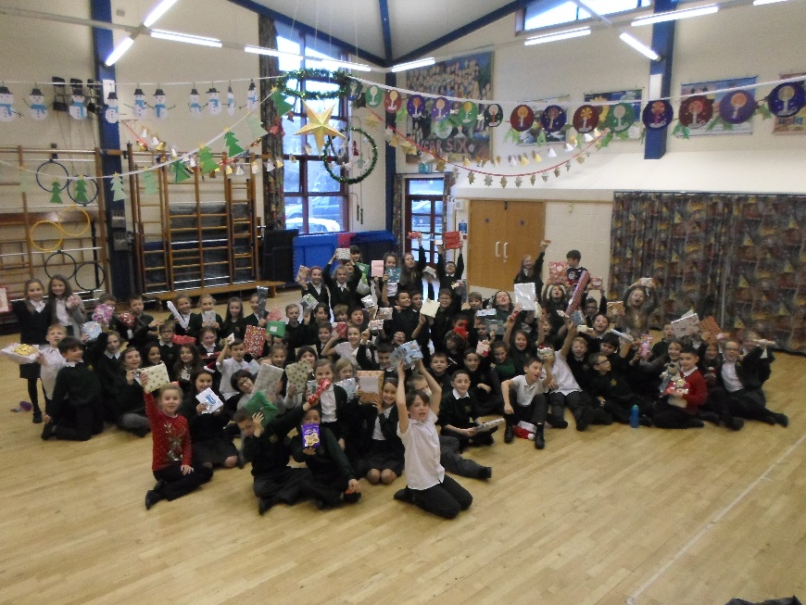
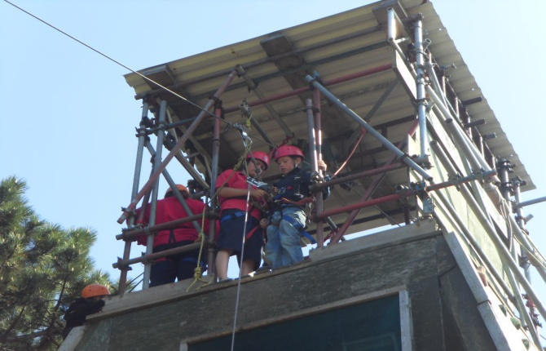
Welcome to our school...
St Saviour’s
Church of England
Junior School

Slide 2
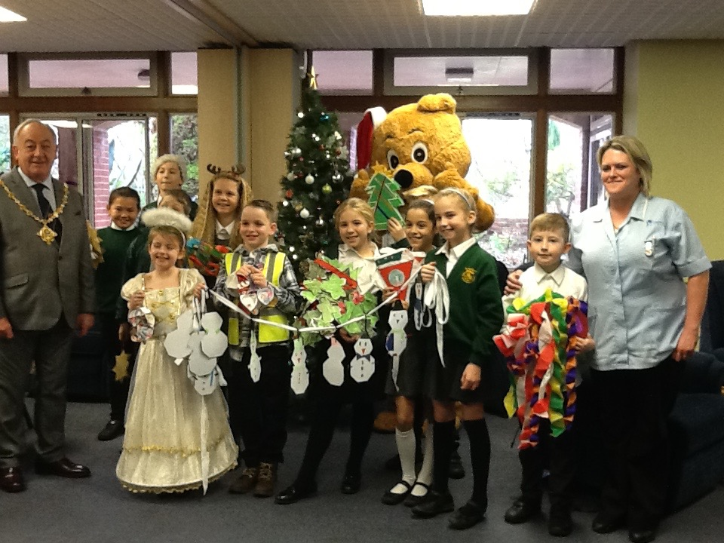
7.00pm Welcome from Chair of Governors Mr G. Neve
7.05pm Welcome from Headteacher, Mr N. Bonell

Slide 3
Christian Values
Christian values inform our actions and thoughts on a daily basis.
Reverence, Wisdom, Thankfulness, Humility,
Endurance,
Service, Compassion, Trust, Peace,
Forgiveness, Friendship,
Justice, Hope, Creation, Community

Slide 4
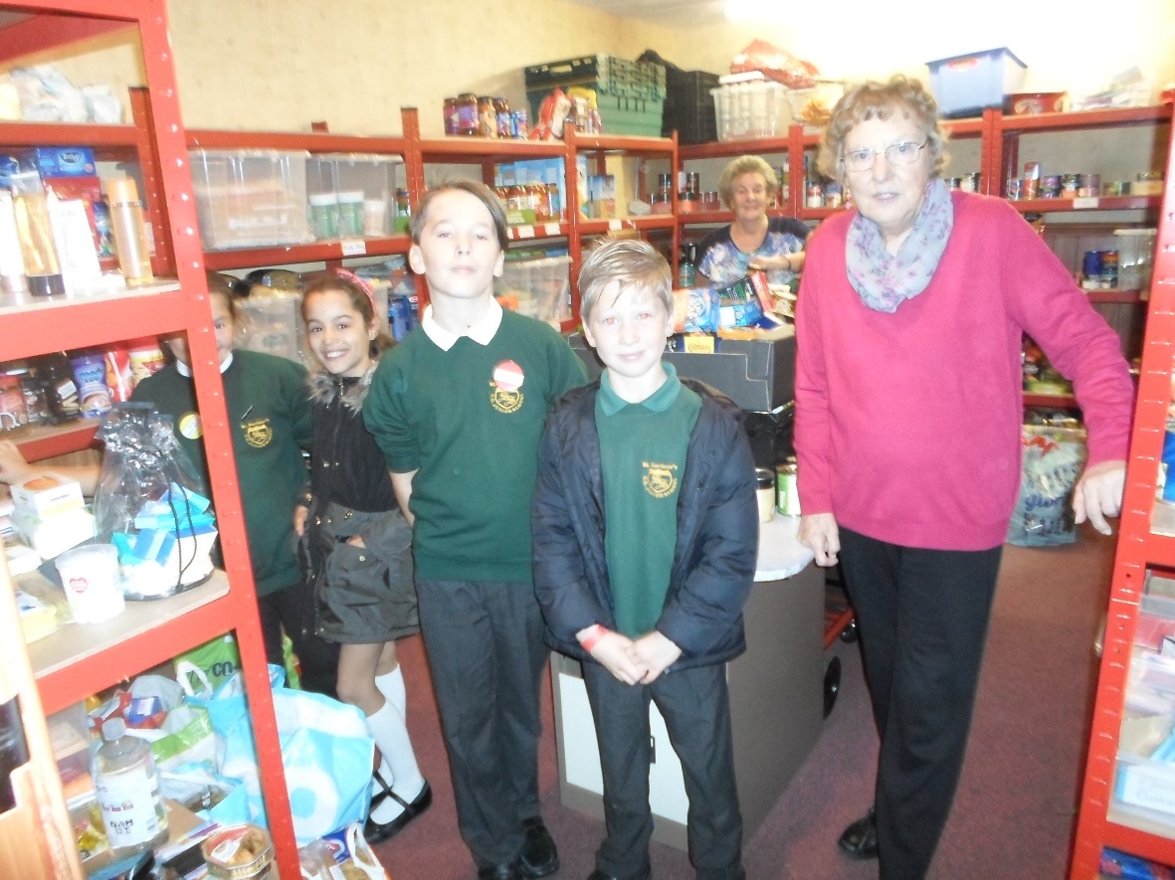
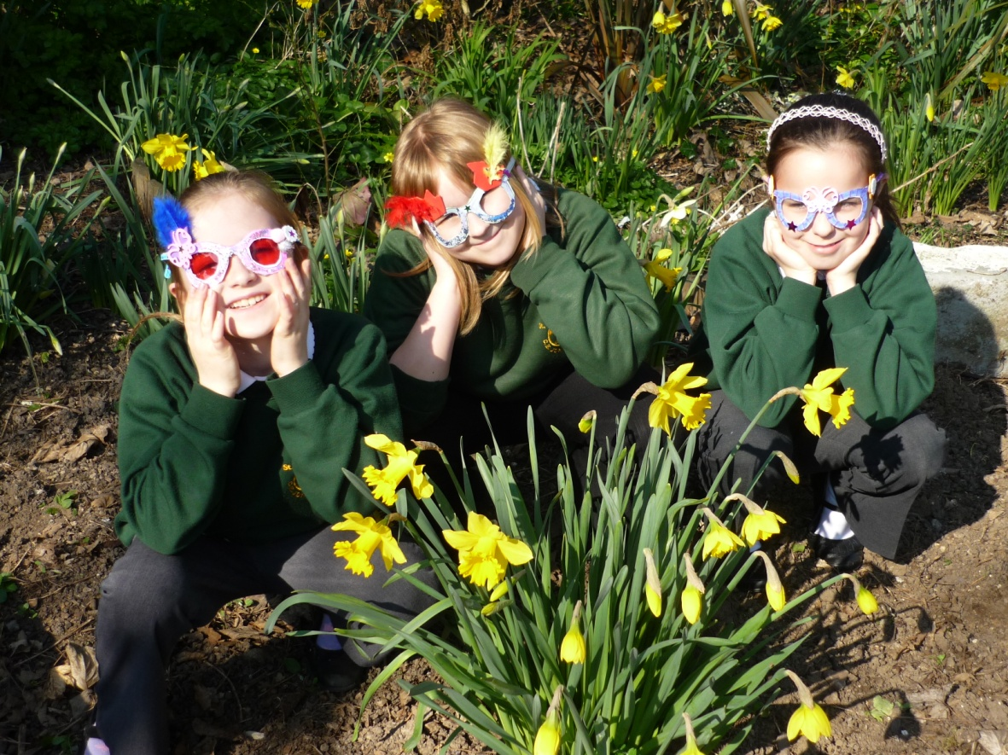
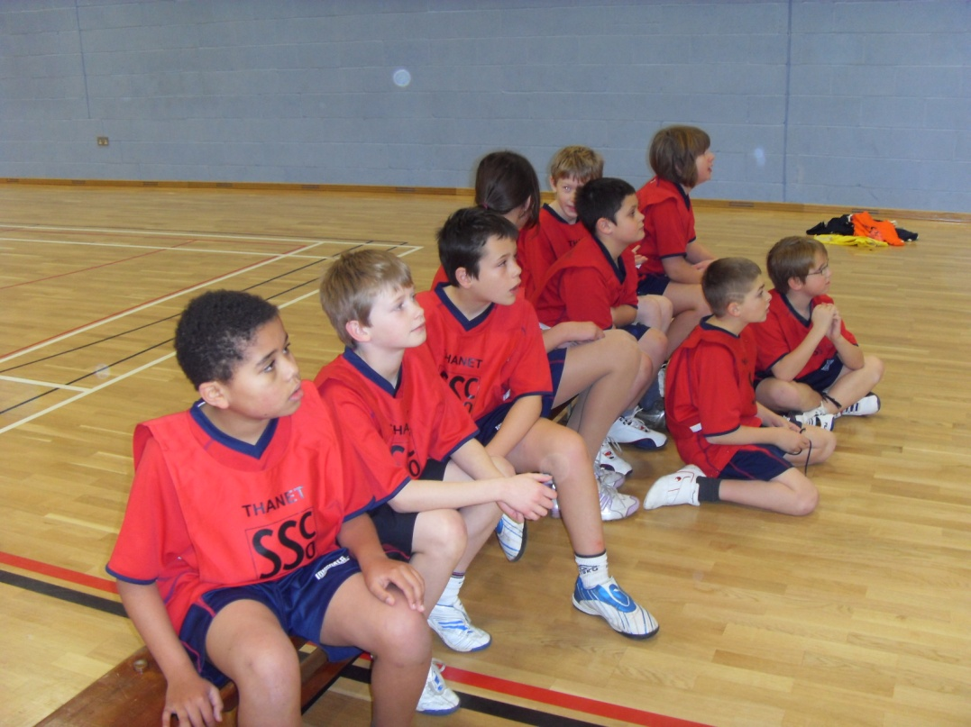
SCHOOL ORGANISATION
KEY STAGE 2 ONLY 7 – 11 years old
Y3 TO Y6
12 CLASSES
3 CLASSES IN EACH YEAR GROUP
TEACHERS
SUPPORT STAFF

Slide 5
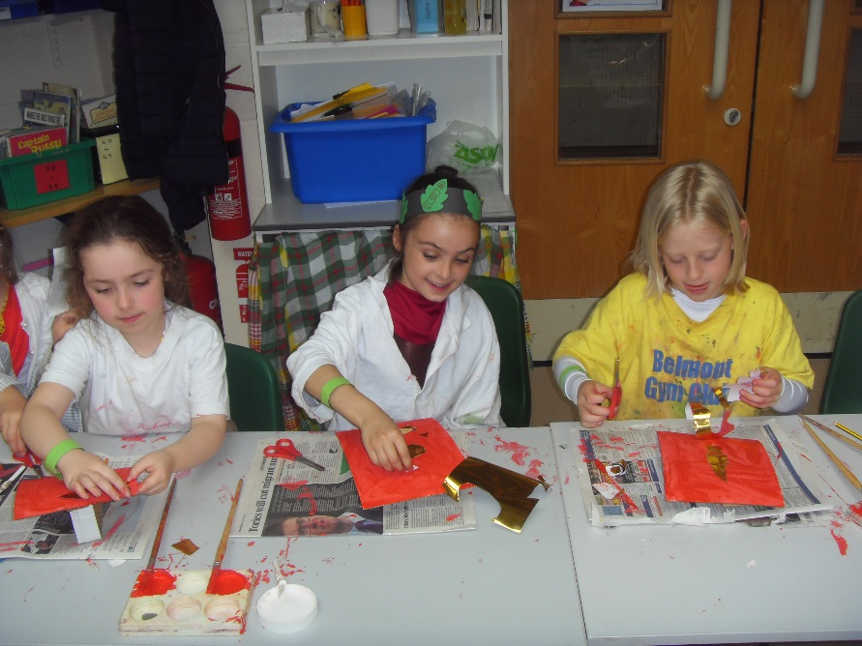
Y3 STAFF
Miss Cook–
Year Group Leader
Mrs Sydenham
Mr Jones
Mrs Kirkaldie– cover teacher

Slide 6
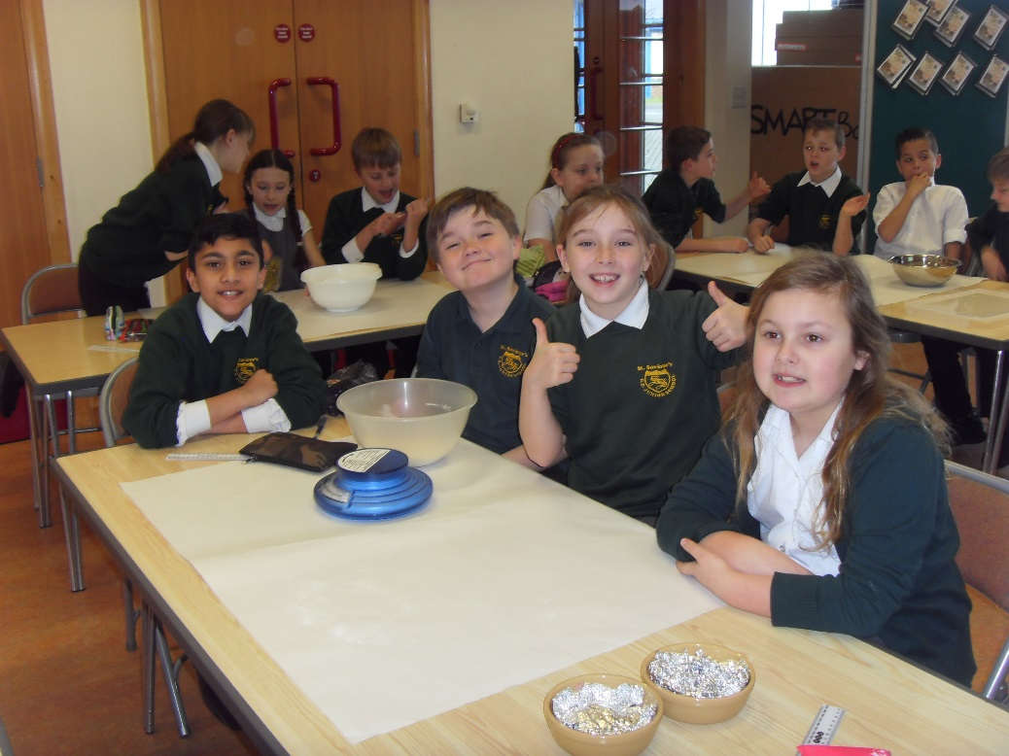
Other staff that your child will meet through the school day…
Mr Arnold
Mr Bonell
Mrs Tift
Mrs Clark
Class teachers
Teaching Assistants
Sports Coach
Office staff
Midday Meals Supervisors
Premises staff
FLO

Slide 7

If you would like to speak to a member of staff…
Make an appointment through the school office
  Not via playground or classrooms
Casually at the end of the school day
  Teachers in Year 3 and 4 come out with children
Avoid the beginning of the day unless it is very urgent
Parent Consultations
OPEN DOOR POLICY

Slide 8
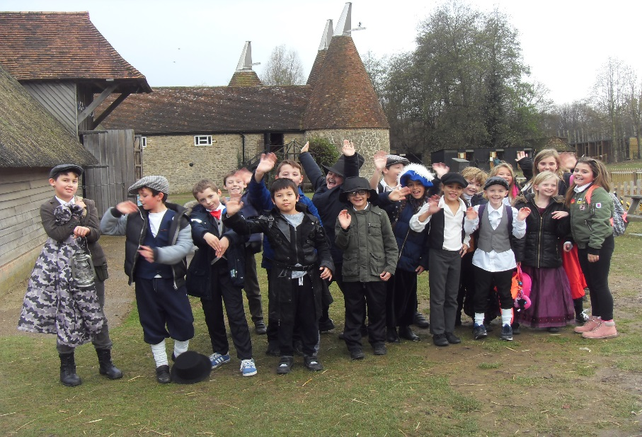
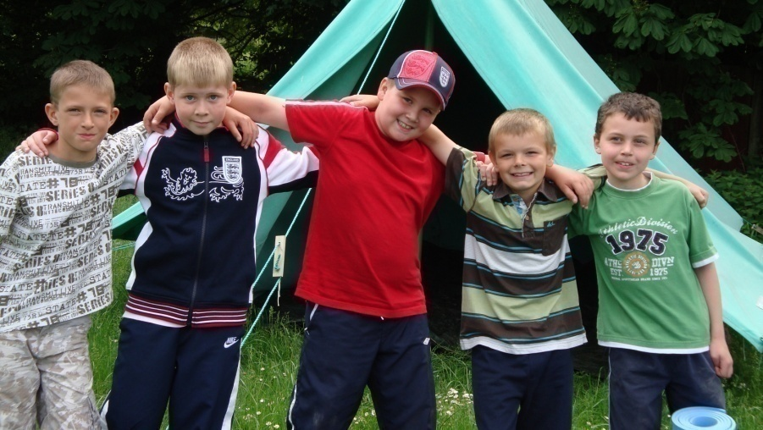
Approach
  Includes visits out of the classroom
  School grounds
  In and around Westgate
  Further afield
  Special Weeks and Days

Slide 9
Maths mastery
Concrete, Pictorial, Abstract
Children moving through topics together, more able are encouraged to apply knowledge and gain a deeper understanding rather than jumping ahead
Flexible interventions for children who have struggled in a lesson
Accelerated Reader
Initial reading test
Finely graded books
Quiz after every book
Targets

Slide 10
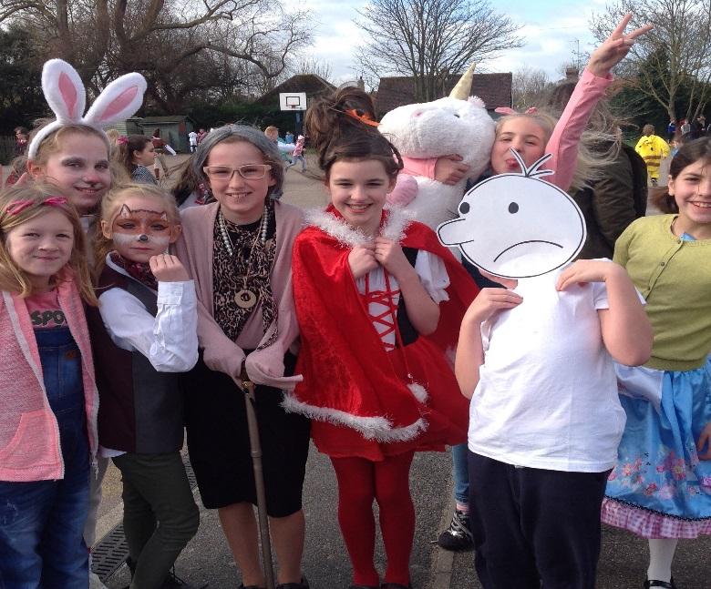
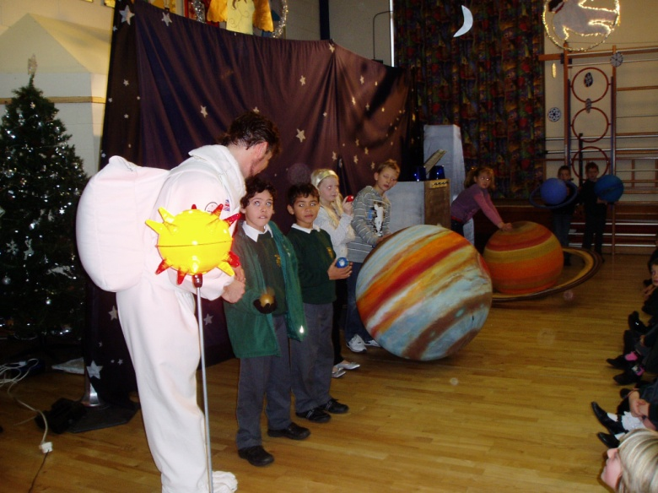
Homework
Homework will be set to
  support learning in the classroom
  reinforce or practise skills already introduced
  make learning fun
Reading
  Children reading and reading to children
  Research
Times tables

Slide 11
Christian Ethos
Church of England
Signs of a Christian School
  Collective Worship
    Class, Lower/Upper KS, whole-school
    St Saviour’s Church
    Harvest, Christmas, Easter & services of
    Thanksgiving
Parents have a right to withdraw their children from RE and/or Collective Worship

Slide 12


Extra Curricular Activities
Football
Netball
Cricket
Dance
International Film club
Table Tennis
Choir
Chess
Computer
Gardening
Animation
Country dancing
Radio Controlled Cars
Art and craft
Library
Rugby ………………!!!
These are usually after school but could be before school or during lunchtime.
The first club for all children will be free. Second or third clubs will be £1 per week subject to spaces being available.

Slide 13
Website...
Key information: term dates for pupils,
prospectus
Calendar: event dates

Slide 14

Behaviour
Supportive parents are very important

Slide 15
Care
Problems – talk to a member of staff –teacher, FLO, TA, DHT, HT
Child Protection
Children who are ill or who have long-term medical needs
Appointments
Casual (on the gate etc)

Slide 16
Communication
Consultations
Reports
Appointments
Casual
Newsletters
Letters
Telephone
Text

Slide 17
School Uniform
  Shoes not trainers or boots
  Black/grey trousers/ skirt
  Sweat shirt or plain green cardigan/jumper (not grey)
  Fleece
  White/Green Polo shirt
  P.E. kit EVERY DAY
    White t-shirt
    Black/Navy shorts
    Not Football Kit
Please make sure all uniform is named. Thank you!

Slide 18

ABSENCE
Contact school by 9.15am if your child is absent
Follow up letter should be given to the class teacher
School will contact you regarding absence
Appointments need to be backed up by a letter or an appointment card
Leave of absence in term time – Pupil Attendance Policy
If you have difficulties in getting your children to school on time our Family Liaison Officer (Mrs Biggs) can help
Poor attendance, which includes arriving after 9.00am, will result in a referral from the school to the Attendance & Behaviour service
  Penalty notices for 10
  unauthorised sessions in
  a seasonal term
Regular absence
and lateness has a
hugely negative influence
on children’s education
and attitude to life!

Slide 19
Beginning & End of Day
Morning
  Breakfast club from 7.45 am (£2.50 per day)
  Gates open at 8.30 am
  Wake and Shake 8.45 am
  Whistle is blown at 8.55 am
Afternoon
- Teaching finishes at 3.15pm
  - Meet children at front of school
No parking
  On yellow zigzags
  Houses opposite school

Slide 20
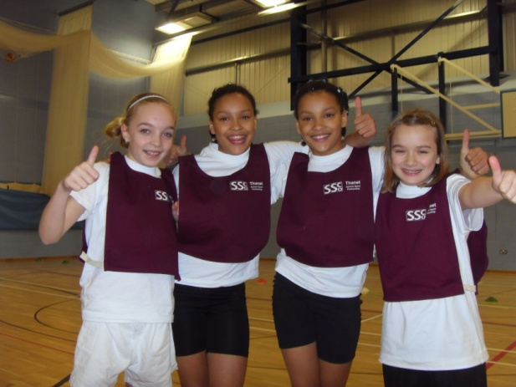
Lunchtime & break
Cooked dinner/packed lunch £2.15 per day
Packed lunch
  No fizzy drinks
  No sweets
  Crisps are allowed for packed lunch
Break
  Healthy tuck shop
  Fruit
  No crisps

Slide 21
What we would like from you!
Essential...
Children who arrive at school on time
Children always in school uniform/PE
To attend all parent consultation evenings
Read regularly with you child (at least three times a week)
Support homework and home learning
Keep contact details up to date
Tell us if there are circumstances which may affect your child

Slide 22
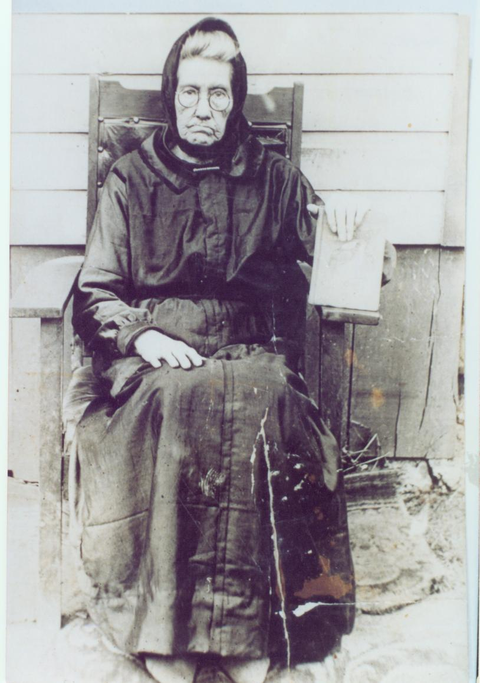

What we would like from you!
Desirable...
...but with over 200 years of combined experience, we have an idea of what makes for happy, high-achieving children!

Slide 23
What we would like from you!
Desirable...
Children have breakfast every morning
Children watch appropriate TV, especially if they have unrestricted TV/Sky in their bedroom
Children do not use 18 rated games on X Box etc (they are 18 for a reason)
Parental monitoring of internet
Children get a good night’s sleep (10 hours for an 8 year old)
Speak favourably about the school and your child’s teacher and respect our professional judgement, even on those rare occasions when we have to agree to disagree
Attend information sessions

Slide 24
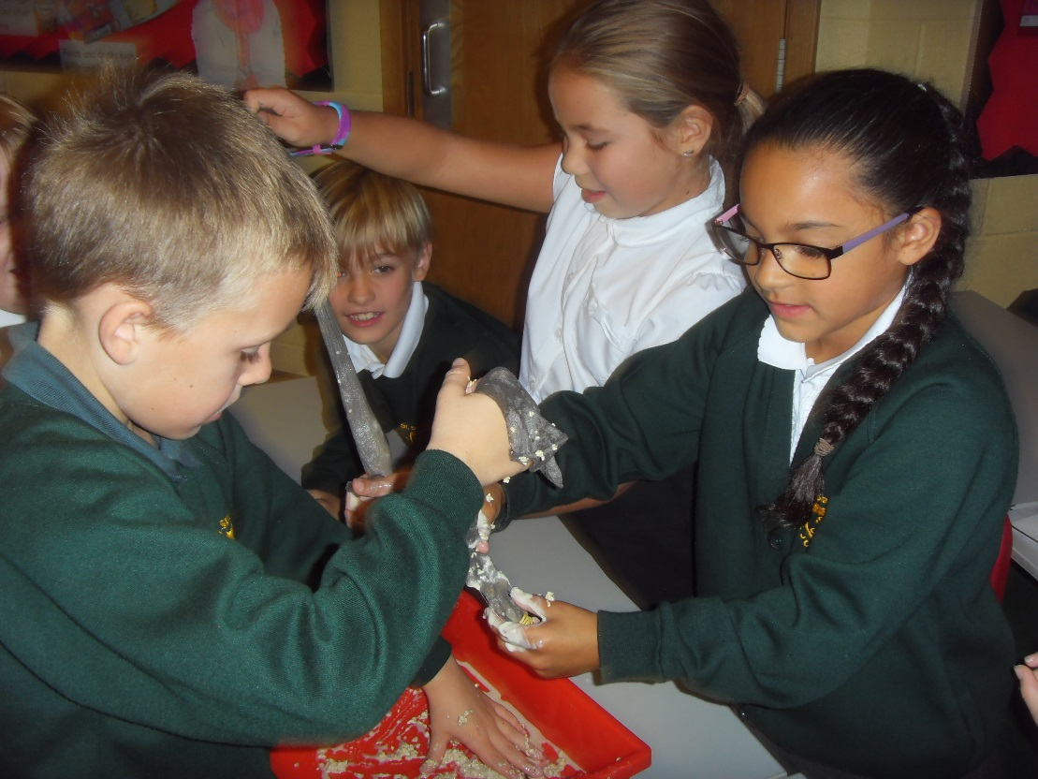
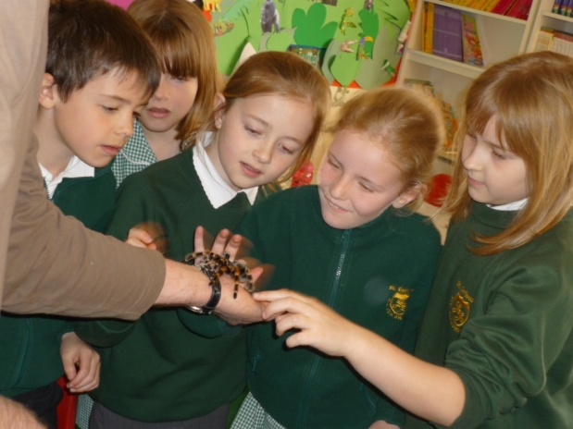
And finally...
We don’t always get it right...but we never,
ever set out to get it wrong … that would just be plain silly!

Slide 25
Please approach a member of staff with any questions.
Our governors will be happy to tell you about their work – we have governor vacancies!

