Slide 1
Welcome to the Information Evening for Year 4
2017-2018

Slide 2
Year Group Leader
Miss Hetterley
Teaching Staff:
Miss Aktar
Mrs Lovelock
Mrs Tyler
Teaching Assistants:
Mrs Alliston, Mrs Theobald-Grainger, Mrs Ward, Miss Smith

Slide 3
Our School Community

Slide 4
Christian Values
Reverence, Wisdom,
Thankfulness, Humility,
Endurance,
Service, Compassion, Trust,
Peace, Forgiveness, Friendship,
Justice, Hope, Creation,
Community

Slide 5
Recognition of Christian Values
Behaviour in and around the school is exemplary from 99% of our children...
We show our recognition of children demonstrating the Christian values in several ways:
Postcards that are sent home so that congratulations can be shared with you;
Excellence certificates that are awarded in achievement assembly;
Team points that are accumulated and displayed in the entrance (Our teams are named after five of the continents).
We are very proud of how the children demonstrate our Christian Values.

Slide 6
Rewards and sanctions
There are a number of privileges in school
which children have, including:
After school clubs and lunchtime clubs
Representing their class/school in events such as sports tournaments and music festivals
Being a monitor
Showing new parents around the school
Taking part in a year group event
There are the rare occasions however, when in addition to missing playtime, these privileges may be removed

Slide 7
A Typical Day

Slide 8
Your children have a very full day!
Wake and shake
Registration
Maths
Assembly
Break
English
Guided Reading
Lunch
Afternoon subjects – the Saxons, Electricity and the rainforest to mention but a few.

Slide 9
Religious Education
Term One – Creation
Term Two – Incarnation
Term Three – Gospel
Term Four – Salvation
Learning about Religion
Learning from Religion

Slide 10
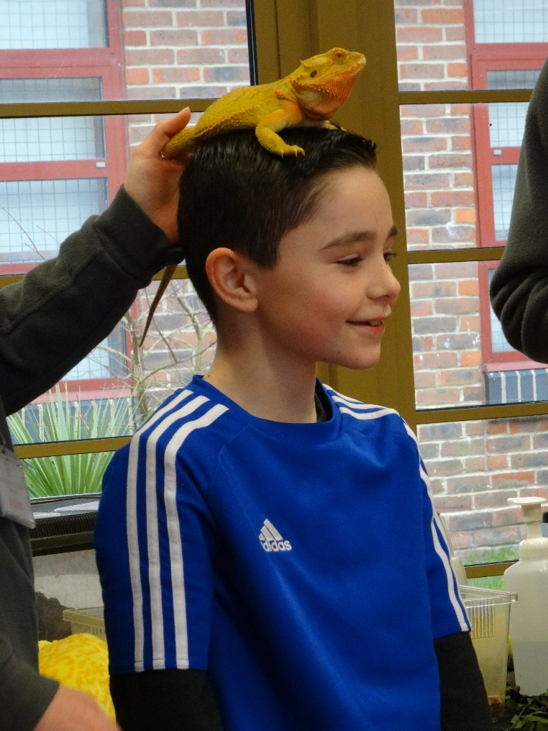
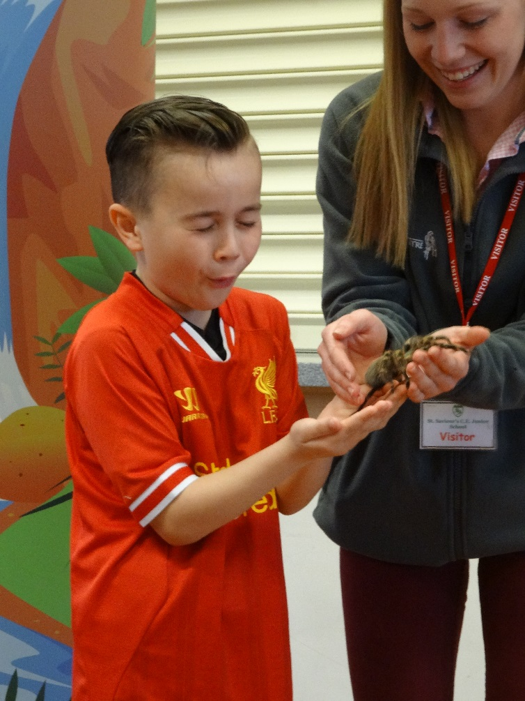
Learning is fun

Slide 11
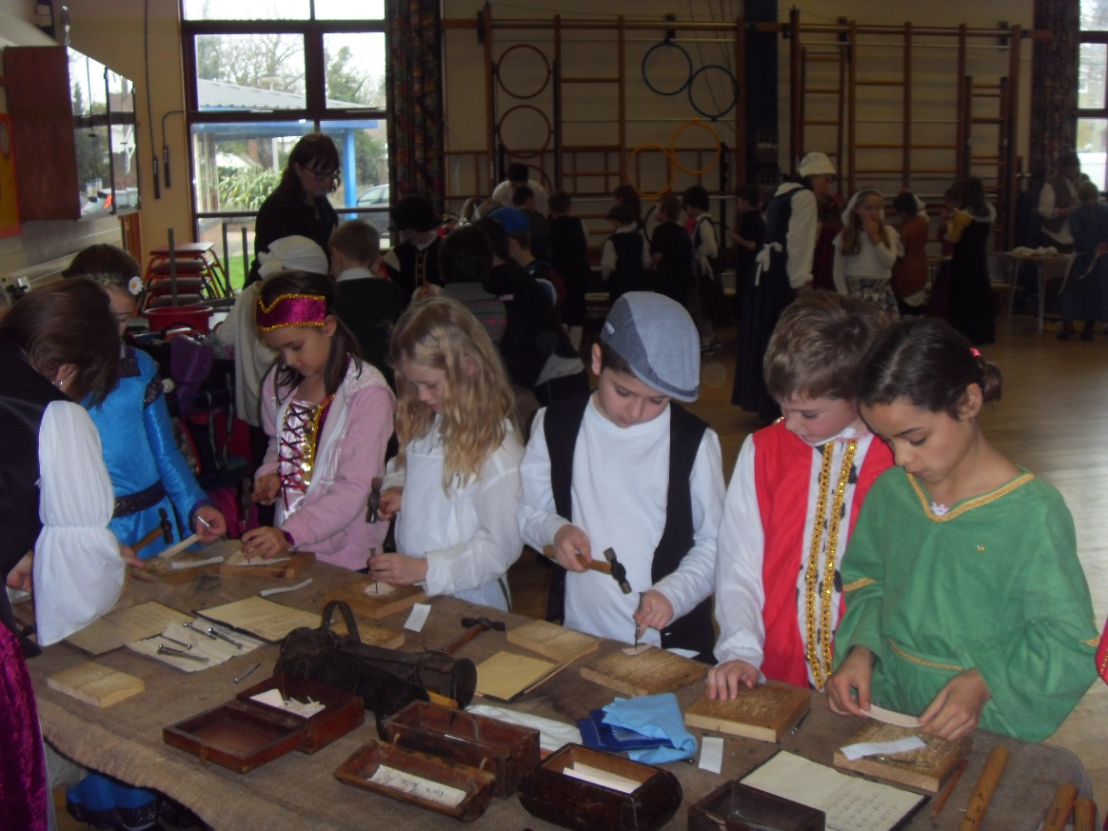
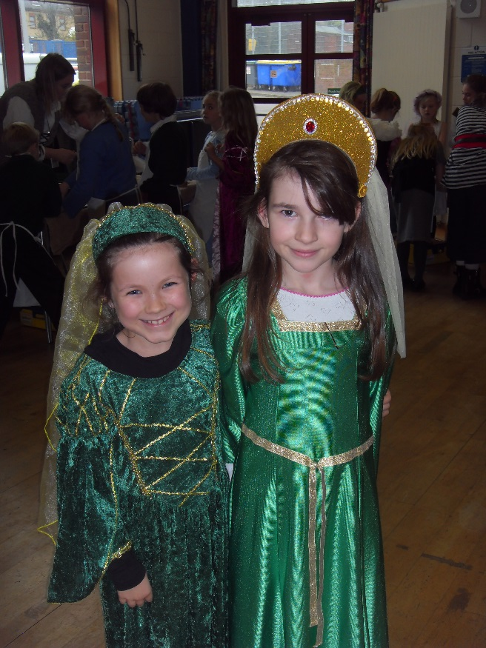
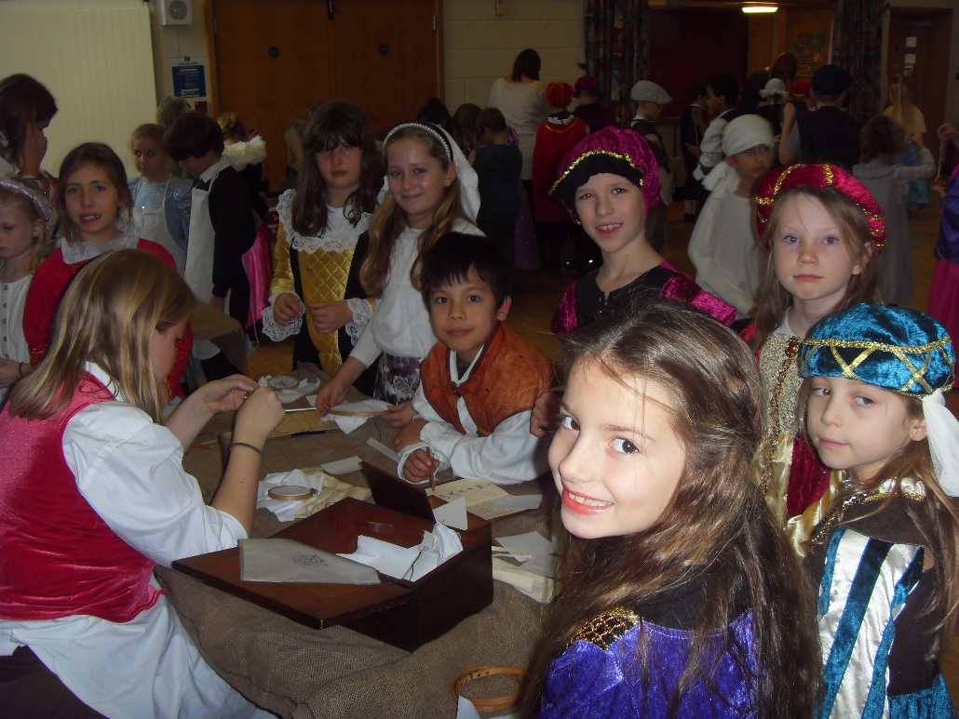

Slide 12
Opportunities
We aim to give the children a broad and balanced curriculum which is purposeful and exciting and to enhanced this, throughout the year, your children are given the opportunity to join in with a number of exciting events and activities linked to their learning.
Term 6 - Camp

Slide 13
Year 4 Camp
One of the biggest and most exciting of our activities is Year 4 camp.
We encourage all children to come to camp, it is a fantastic opportunity and lots of fun.
A good way to prepare is to have a sleepover!
There will be a short information evening for parents closer to the time so that packing lists and extra information can be given out.

Slide 14
Learning that continues at home

Slide 15
Reading - We simply cannot stress enough the importance of reading. In order to access the entire curriculum and all the excitement it has to offer, it is essential that children can read fluently and with understanding. It is for this reason that we ask children to read to you at least three times a week and for you to record your comments and feedback in their reading record.
A Maths task will be set on Manga High a Thursday to be handed in on a Monday. This will start in October.

Slide 16
How can I help my child?
2 minutes = times tables
5 minutes = statutory spelling lists
10 minutes = hear your child read
15 minutes = sentences with joined handwriting
30 minutes+ = writing and redrafting

Slide 17


Library Book
Reading Book
Free Choice
Changed Once a Week
Library Time -Tuesday
Accelerated Reader
Changed as necessary
In school every day with Reading Diary

Slide 18


Slide 19
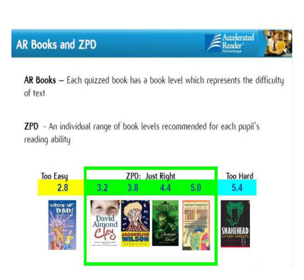

Slide 20
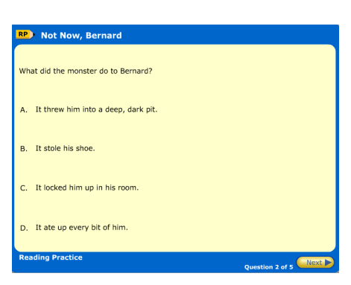
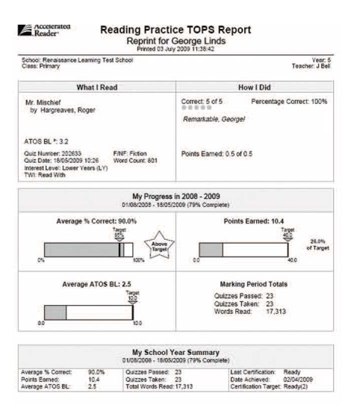

Slide 21
Reading at home
Ability in reading has a huge impact on what children achieve in future – far more than economic background.
We ask that all children read at home at least three times a week.
This could be reading with an adult or by themselves.
Children record reading at home on a wall chart in their classroom – with weekly certificates for whoever has impressed their teacher the most!

Slide 22
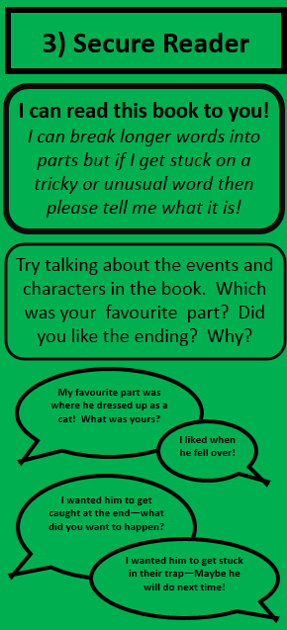
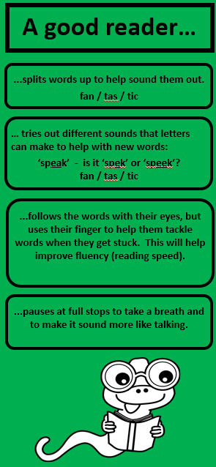
Bookmarks!
(To go home next week)
5 different levels
How you can support word reading and understanding

Slide 23
Spelling at St Saviour’s
which
w HIC h
Children will be learning CLUES to help with new spellings.
grammar
Pirates like gramm – ar!
We will send some at you child’s level home later this term – they will be able to teach you how to help them!

Slide 24
Assessment in Year 4

Slide 25
In Year 4 we use formal assessments to find out the children’s:
Maths, Reading and Writing ‘level.’
Below
Working towards
Low Expected
Secure Expected
Greater depth
70-85 | 86-94 | 95-99 | 100 | 101-105 | 106-114 | 115-130+
Very low | Moderately low | Average |  |  | Moderately high | Very high
Lowest third of year group |  | Middle third of year group |  |  | Highest third of year group

Slide 26
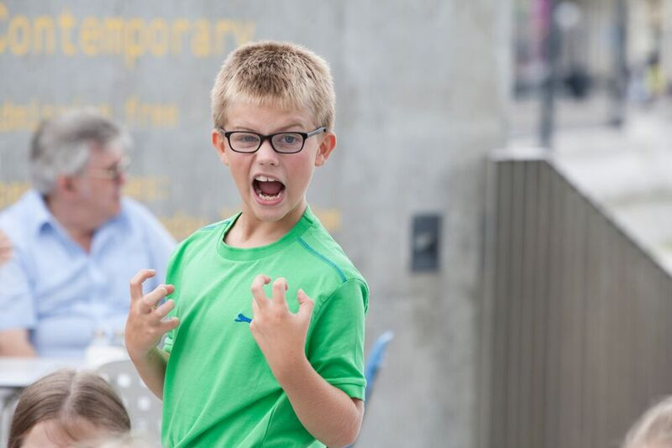
Extra bits and pieces

Slide 27
e-safety
We will be repeating our e-safety evening this year. If your child
has a mobile ‘phone or access to a computer/internet via iTouch
etc it is vital that you come along
SAFE - Staying safe involves being careful and not giving out your name, address, mobile phone number, school name or password to people online.
MEETING someone you have contacted in cyberspace can be dangerous. Only do so with your parent's/carer's permission, and then when they can be present.
ACCEPTING e-mails or opening files from people you don't really know or trust can get you into trouble - they may contain viruses or nasty messages.
RELIABLE - Someone online maybe lying about who they are, and information you find on the Internet may not be reliable.
TELL your parent or carer if someone or something makes you feel uncomfortable or worried.
SMART rules

Slide 28




Helpful sites

Slide 29
Extended school...
Breakfast Club 7.45-8.45am £2.50 per day
Family events after school and in the holidays
Please see Mrs Biggs for more information

Slide 30
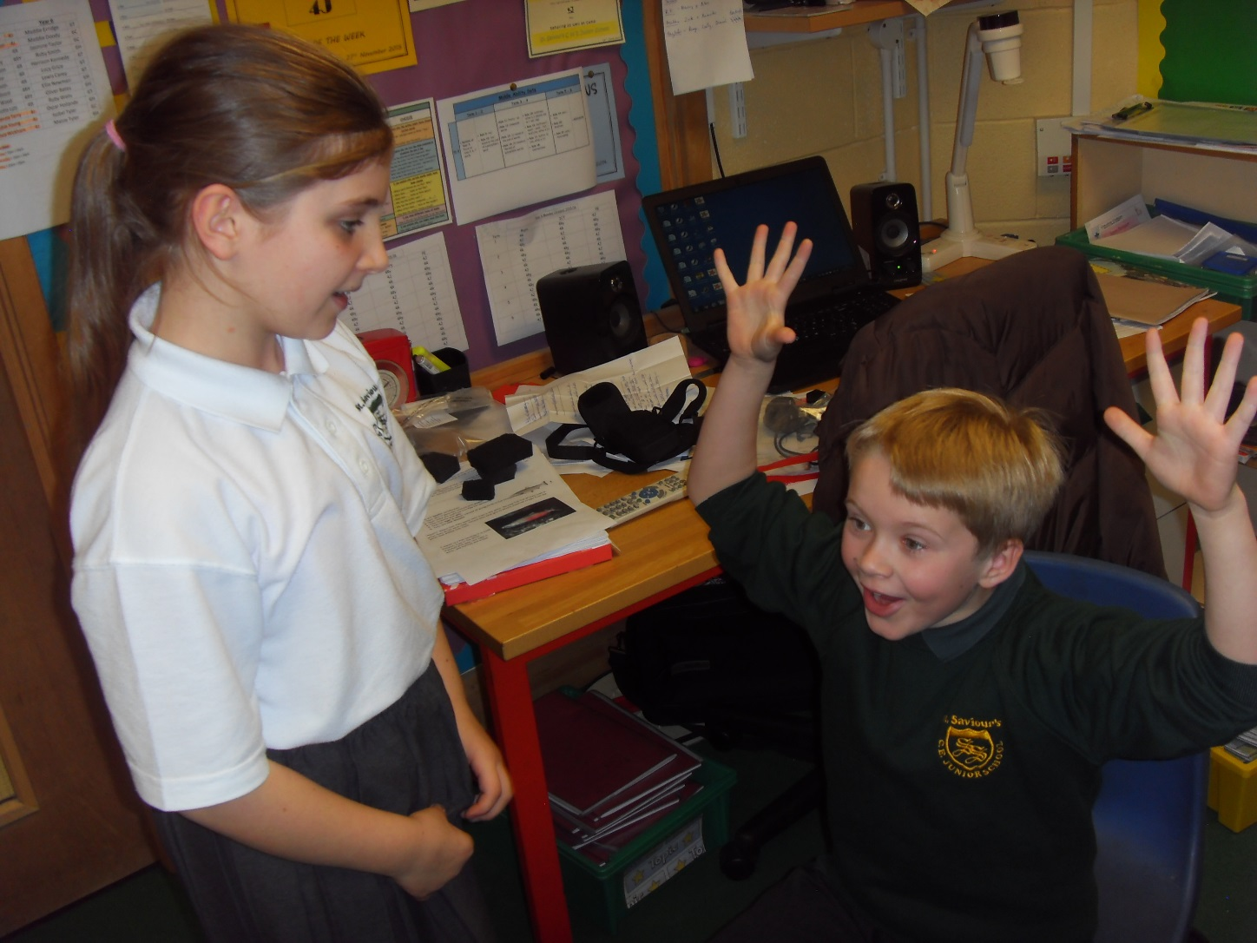
Website
www.stsavioursjunior.com
Term dates
Calendar

Slide 31
If you have concerns...
Generally concerns should be raised in this
order...
Class teacher
Year group leader
Mr Arnold
Mr Bonell

Slide 32
What we would like from you!
Essential...
Children who arrive at school on time
Children always in school uniform/PE kit
To attend all parent consultation evenings
Read regularly with your child (at least
three times a week)
Support homework and home learning
Keep contact details up to date
Tell us if there are circumstances which
may affect your child

Slide 33
What we would like from you!
Desirable...
Children have breakfast every morning
Children watch appropriate TV, especially if they have unrestricted TV/Sky in their bedroom
Children do not use 18 rated games on PSP/X Box etc (they are 18 for a reason)
Parental monitoring of internet
Children get a good night’s sleep ( minimum10 hours for an 8 year old)
Speak favourably about the school and your child’s teacher and respect our professional judgement, even on those rare occasions when we have to agree to disagree
Attend information sessions

Slide 34
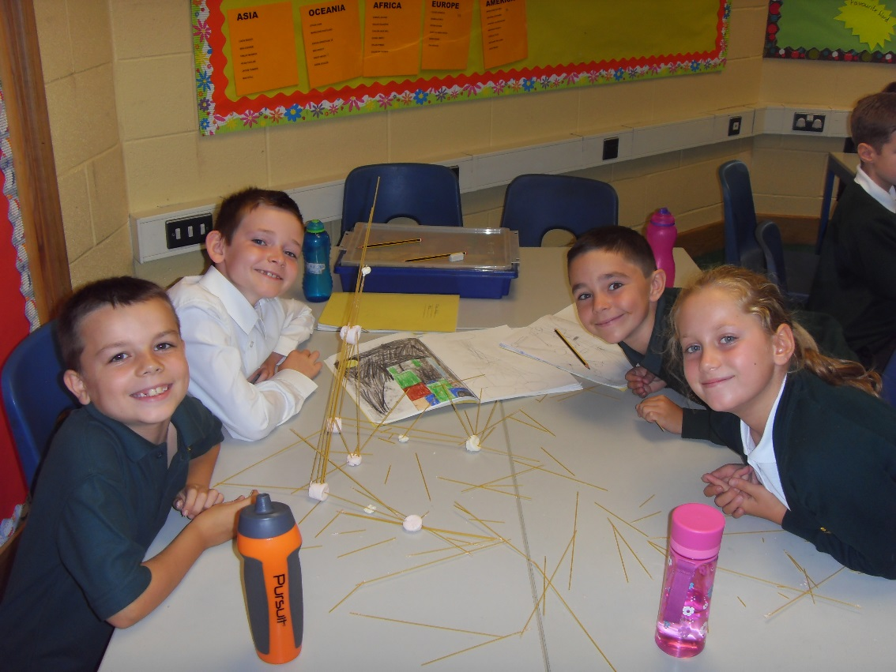
And finally...
We don’t always get it right...but we never,
ever set out to get it wrong ‘cos that just
would just be plain silly!

