Slide 1
Information evening for Year 5
2017-2018
All slides will be available on the school’s website

Slide 2
Year 5 Staff
Year Group Leader : Miss Kemp (5K)
Teaching Staff : Miss Hudson (5H)
Mrs VanPoppel (5P)
Set Teachers: Miss Tanner
Teaching Assistants: Mr Whitehead
Mrs Dally

Slide 3
Christian Values
The Christian Values inform our actions and thoughts on a daily basis.
Reverence
Wisdom
Thankfulness
Humility
Endurance
Friendship
Justice
Hope
Creation
Community
Service
Trust
Compassion
Peace
Forgiveness

Slide 4
Rewards and sanctions
Behaviour in and around the school is exemplary
from 99% of our children...
There are a number of privileges in school which children have including:
After school clubs
Representing their class/school in events such as sports tournaments, music festivals
Being a monitor
Showing new parents around the school
Taking part in a year group event
These privileges may be removed in addition to
missing playtime. Our job is to ensure that all children are kept happy and safe.

Slide 5
What we would like from you!
Essential...
Children who arrive at school on time
Children always in school uniform/PE kit
To attend all parent consultation evenings
Read regularly with your child (at least three times a week), preferably aloud
Support homework and home learning
Keep contact details up to date
Tell us if there are circumstances which may affect your child

Slide 6
What we would like from you!
Desirable...
Children have breakfast every morning
Children watch appropriate TV, especially if they have unrestricted TV/Sky in their bedroom
Children do not use 18 rated games on PSP/X Box etc (they are 18 for a reason)
Parental monitoring of internet, including apps and social media – children are curious and don’t always recognise dangers
Children get a good night’s sleep (minimum10 hours for an 8 year old)
Speak favourably about the school and your child’s teacher and respect our professional judgement, even on those rare occasions when we have to agree to disagree
Please attend information sessions

Slide 7
Homework
We have a mixture of more traditional homework tasks and ‘home learning’ projects.
Children are expected to read every night for at least ten minutes.
We have decided not to set formal written English homework this year. Key spellings for year 5 children will be available on the website.
Maths homework will be set on ‘Manga High’ website from October.
To run alongside the topics we are covering in the foundation subjects children will have a home learning sheet with a range of activities to involve other family members.

Slide 8
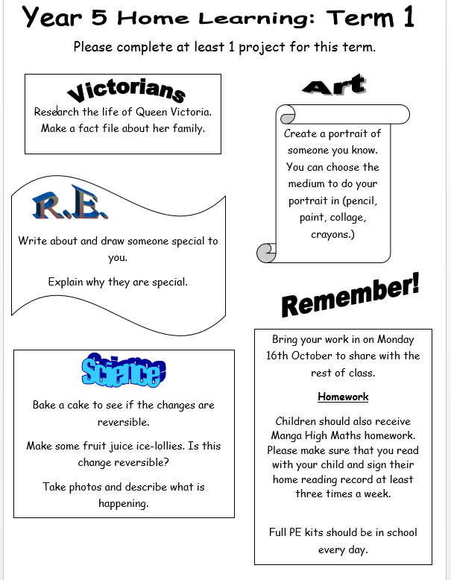

Slide 9
A typical day
8:45 – Wake and shake
8:50 – Registration
9:00 – Maths
10.20 - Assembly
10:35 – Break
10:50 – English (including guided reading)
12:20 – Lunchtime
1:20 – Afternoon lessons
3:15 – End of day

Slide 10
Extended school...
Breakfast Club 7.45-8.45am £2.50 per day
Coffee mornings: 29th Sept, 23rd Nov, 15th Dec
You will need to register in the office
Family passport activities will continue during the holidays this year.
Activities so far have included Beach Hut days, Day trip to Brighton, Environmental day, Science days and many more
Please see Mrs Hearn or Mrs Biggs for more
information

Slide 11
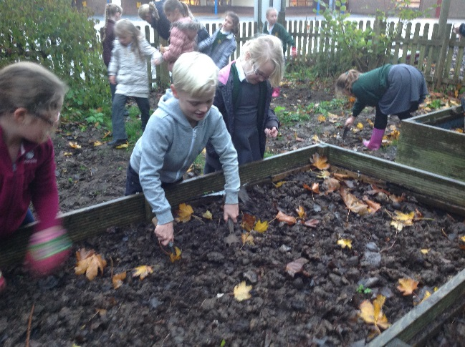
Clubs
There are many after school clubs running on a two termly basis.
In addition to these there are also clubs that run at lunchtimes.
Instrumental tuition is available – guitar, strings, woodwind and brass.
The whole of the year group are
learning the recorder this year.

Slide 12
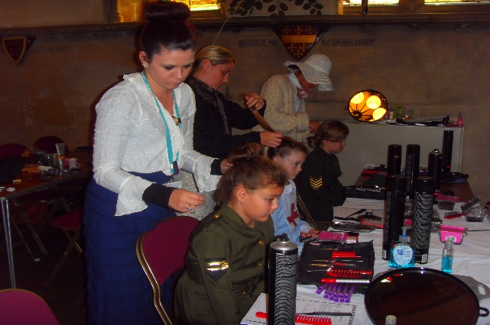
Trips, Visits and
Themed Days
In Term 2 children will take part in a Victorian Experience Day, they will need a Victorian costume for this trip- this trip has been booked for Thursday 7th December. A letter will be sent home closer to the time.
During Term 3 we hold a Pirate Day to link with an English unit of work on Treasure Island. A simple costume will be required.
In Term 5 we visit Wildwood as part of a Science topic on Life Cycles.
Term 6 Puberty.
Over the course of the year children will spend time at St Saviours church and the surrounding town as part of our local history unit.

Slide 13
Year 6 Residential to Kingswood
This trip will be Spring/Summer 2019.
Letters to sign up will be sent home June/July 2018.
There are limited spaces.
Payment throughout academic year 2018/2019.

Slide 14
School Library
Children can have up to 2 books at a time
Books are lent out via a computerised system and assigned to your child through their unique barcode
If books remain missing when we audit the library each term, parents will be asked for the full replacement cost. In the meantime, your child will not be able to borrow another book
There are library sessions timetabled before school and at lunchtimes every week – please encourage your child to come along

Slide 15
Reading at home
Ability in reading has a huge impact on what children achieve in future – far more than economic background.
We ask that all children read at home at least three times a week.
This could be reading with an adult or by themselves.
Children record reading at home on a wall chart in their classroom – with weekly certificates for whoever has impressed their teacher the most!

Slide 16
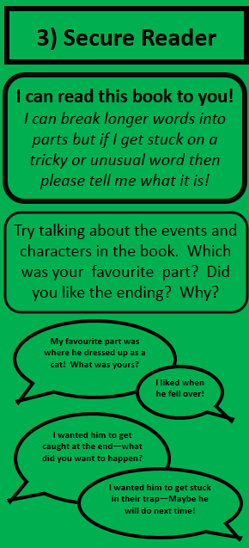
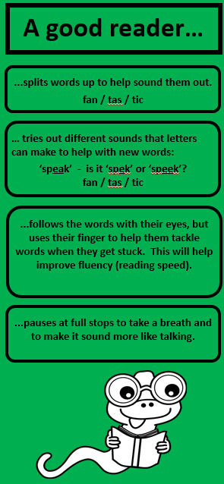
Bookmarks!
(To go home next week)
5 different levels
How you can support word reading and understanding

Slide 17


Slide 18
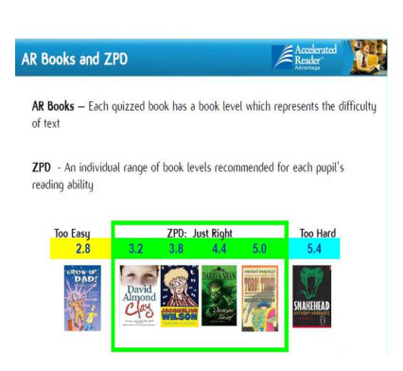

Slide 19
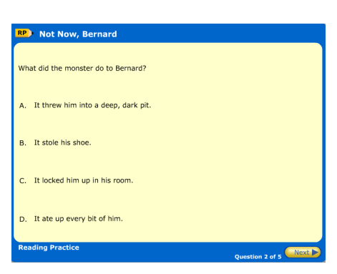
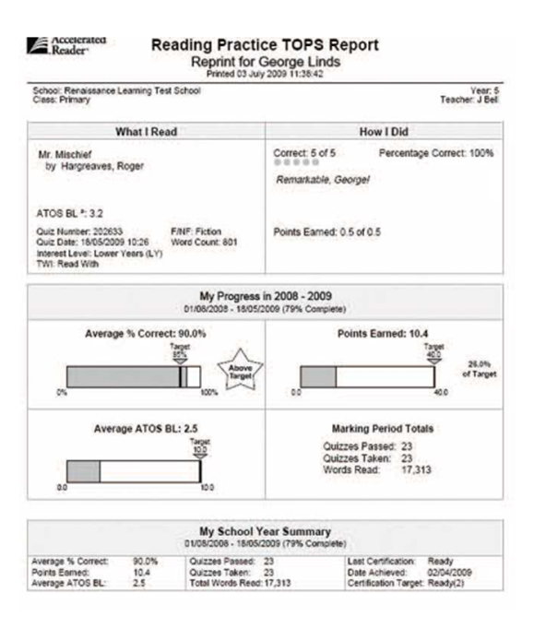

Slide 20
Spelling at St Saviour’s
which
w HIC h
Children will be learning CLUES to help with new spellings.
grammar
Pirates like gramm – ar!
We will send some at you child’s level home later this term – they will be able to teach you how to help them!

Slide 21
e-Safety
Key Advice for Parents/Carers
Talk to your child and understand how they are using the internet and their phone
Use safety tools and parental controls – if you’re not sure how contact your service provider:
- Please note tools are not always 100% effective
Facebook and Instagram– Accounts for over 13s only.
Your child is just as likely to be a bully as to be a target. Be alert to your child being upset after using the internet/phones – they may be secretive, change relationships with friends
Remind your child not to retaliate
Keep any evidence of Cyberbullying – emails, Online Conversations, texts etc to show the school/police etc
Report the Cyberbullying:
  – Contact the school so they can take action if it involves another pupil
  – Contact the service provider
  – If the Cyberbullying is serious and a potential criminal offence has been committed then consider contacting the police

Slide 22
SMART rules
SAFE - Staying safe involves being careful and not giving out your name, address, mobile phone number, school name or password to people online.
MEETING someone you have contacted in cyberspace can be dangerous. Only do so with your parent's/carer's permission, and then when they can be present.
ACCEPTING e-mails or opening files from people you don't really know or trust can get you into trouble - they may contain viruses or nasty messages.
RELIABLE - Someone online maybe lying about who they are, and information you find on the Internet may not be reliable.
TELL your parent or carer if someone or something makes you feel uncomfortable or worried.

Slide 23
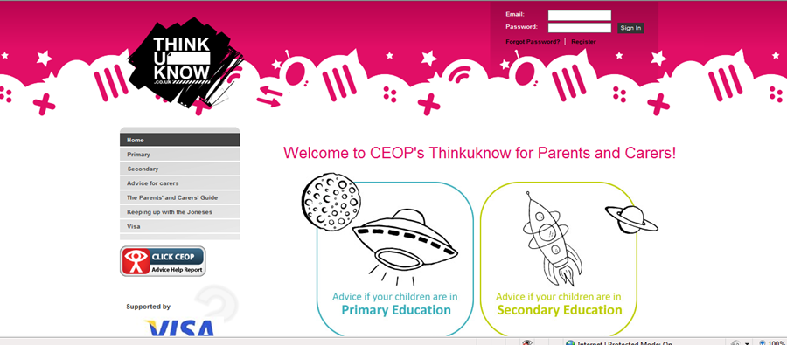
Parents Resource www.thinkuknow.co.uk/parents

Slide 24
Year 5 tests
- Reading Ages
- Spelling Ages
- QCA tests in May (Maths, Reading, GPS)
- Non-Verbal Reasoning

Slide 25
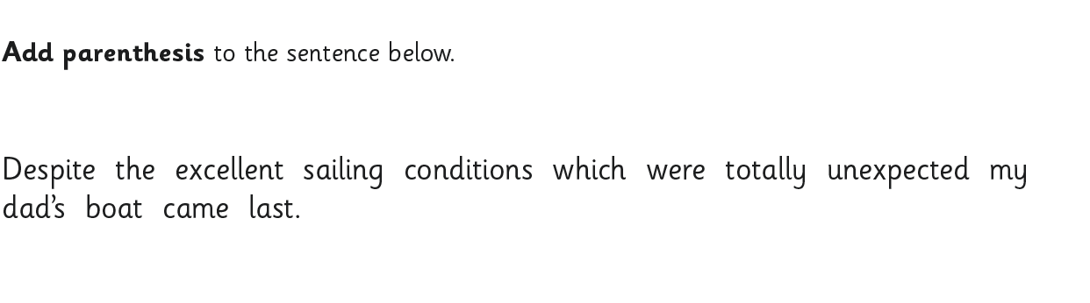
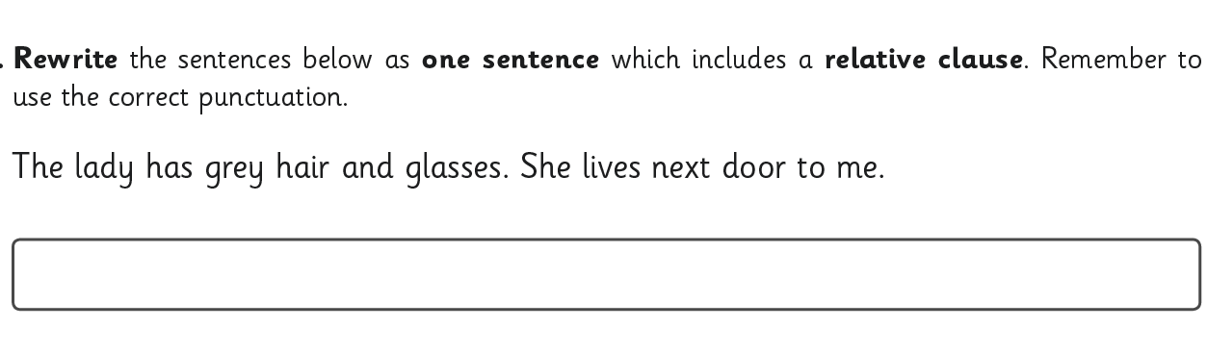
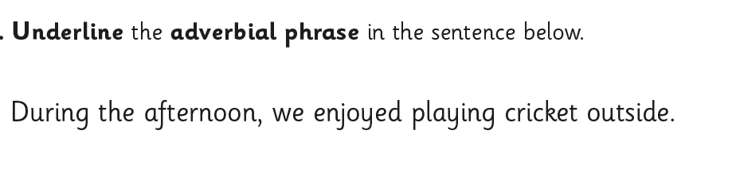
Example test questions

Slide 26
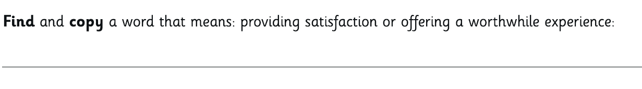
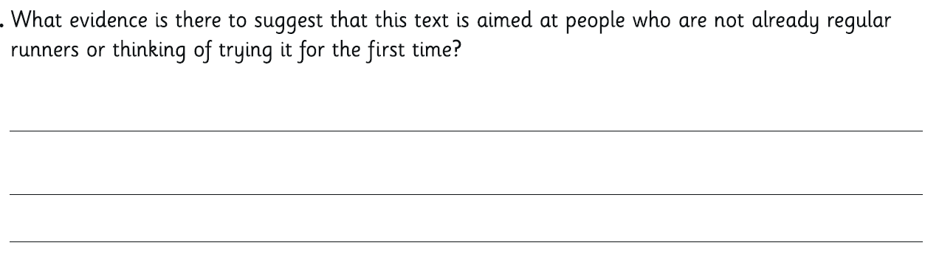
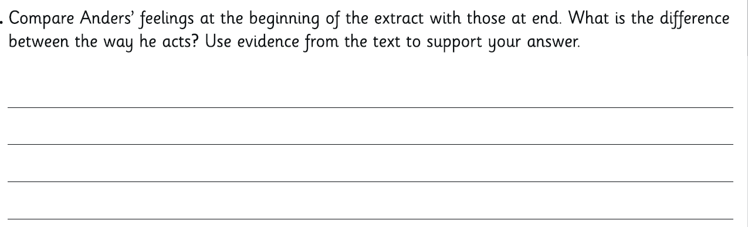
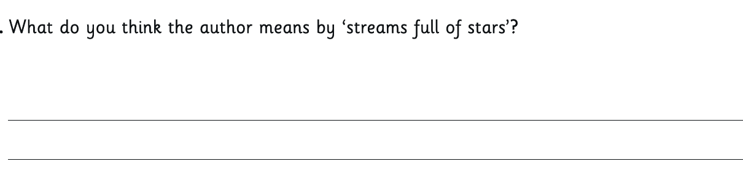
Example test questions

Slide 27
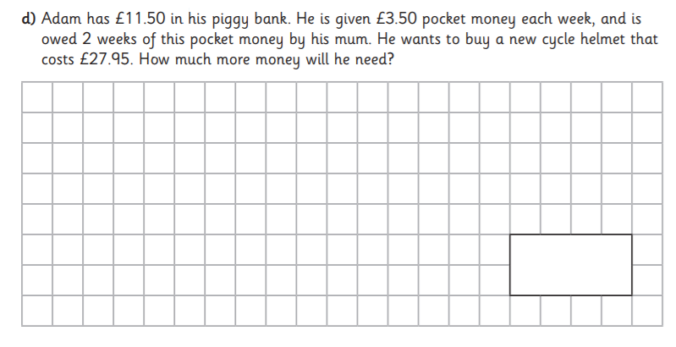
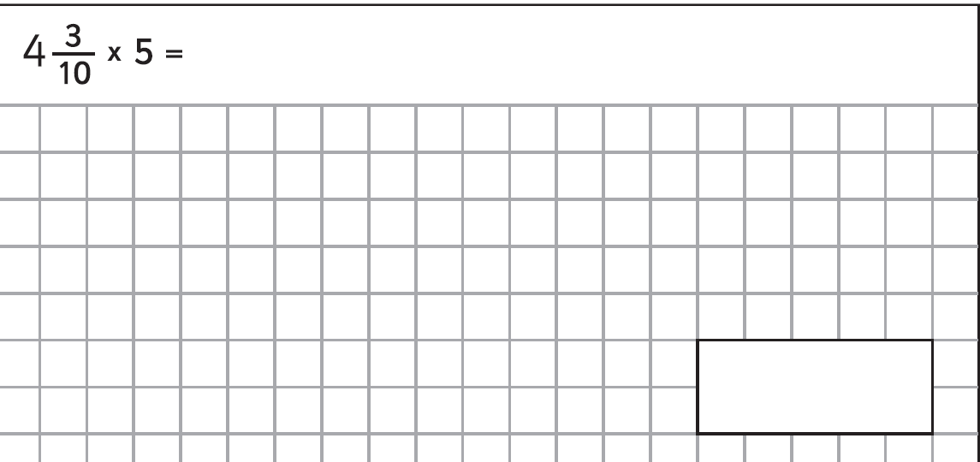
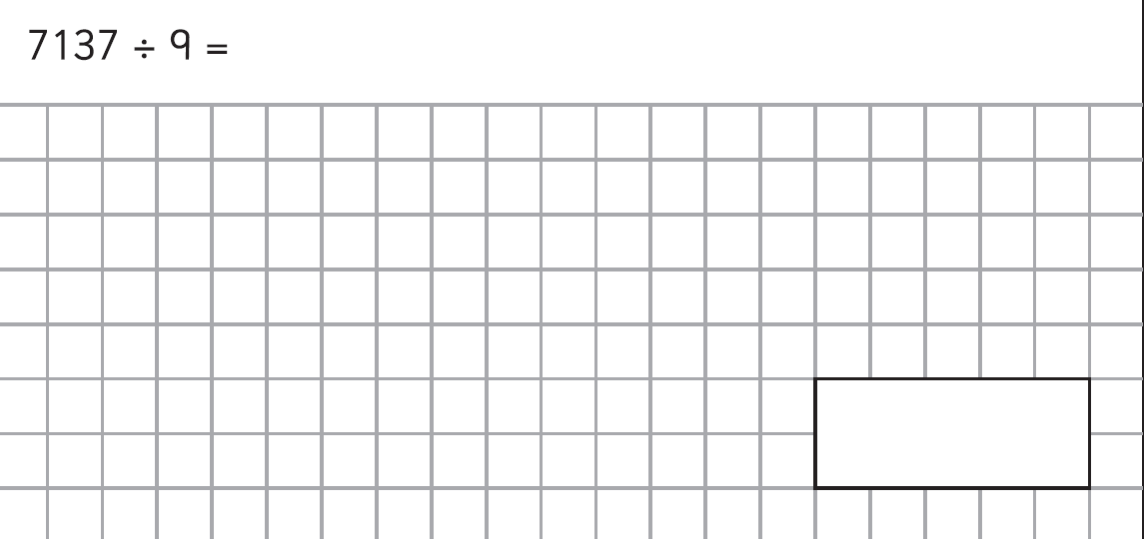
Example test questions

Slide 28
Year 5 Kent Test
What are the tests like? (different from a few years ago!)
…apart from Maths and English, nothing like they have in school!
Four tests of approximately 25 minutes each:
Verbal Reasoning (VR)
Non-Verbal Reasoning/Spatial Reasoning
Mathematics
English (Comprehension, Spelling and Punctuation)
They are multiple choice papers
There is also a writing task, which can be used for those children who are borderline

Slide 29
Year 5: Should my child take the Kent Test?
Indicators include:
- Key Stage 1 scores
- Year 4 scores
- Child with high self-motivation
- Tasks are completed in lessons to a good standard
- Reading/spelling age above chronological age
- Current Year 5 Maths and/or English set
- Teacher recommendation in June 2017
- Predicted Year 6 grades (generally need to be ‘exceeding’)
Consider how would they/you feel if they were unsuccessful?

Slide 30
Would my child be suited to a grammar school?
Do they enjoy school and want to learn?
Do they get on with their homework without a big battle? (There can be up to two hours homework a night at grammar schools.)
Do they do consistently well across the curriculum?
Do they enjoy the challenge of being in top sets?
We recommend familiarisation and the sooner the better. Whether you decide to get a tutor or help your child yourself is up to you. Papers can be bought in WHSmith, Staples etc.

Slide 31
Year 5: 2016 results
The pass mark is different every year. It is set depending upon the range of results children achieve.
The pass mark is adjusted very slightly to allow for a child's age when they take the test.
A standardised score of 100 represents an average performance for a child of a given age, with the lowest standardised score normally around 70 and the highest around 140.

Slide 32
Free School Meals
Income Support
Income-based Jobseekers Allowance
Income-related Employment and Support Allowance
Support under Part VI of the Immigration and Asylum Act 1999
the guaranteed element of State Pension Credit
Child Tax Credit (provided you’re not also entitled to Working Tax Credit and have an annual gross income of no more than £16,190)
Working Tax Credit run-on - paid for 4 weeks after you stop qualifying for Working Tax Credit
Universal Credit

Slide 33
If you are unsure, apply anyway!
There is no different food, different tables, different treatment – in short no difference!
Everyone is finding times hard at the moment – one less thing to pay for can make a big difference.
Hot meal or school packed lunch.
Everyday or only once in the whole year.

Slide 34
Website
www.stsavioursjunior.com
Term dates (don’t refer to KCC website as they don’t include training days)
Remember we can no longer grant any holiday during term times.

Slide 35
If you have concerns...
Generally, concerns should be raised in this
order...
Class or set teacher
Year group leader
Mr Arnold
Mr Bonell

Slide 36
And finally...
We don’t always get it right...but we never,
ever set out to get it wrong ‘cos that
would just be plain silly!

