Slide 1
Information evening for Year 6
2017-2018
All slides will be available on the school’s website

Slide 2
Year 6 Staff...
Year Group Leader – Mrs Gray (6G)
Teaching Staff – Miss Clark(6TC) Mrs Tift (6TC)
Miss Stiff (6S)
Teaching Assistants – Miss Curran Mrs Gardner
Mrs Lucas

Slide 3
Christian Values
Christian values inform our actions and thoughts on a daily basis.
Reverence, Wisdom, Thankfulness,
Humility, Endurance, Service,
Compassion, Trust, Peace, Forgiveness, Friendship, Justice, Hope, Creation,
Community

Slide 4
Rewards and sanctions
Behaviour in and around the school is exemplary
from 99% of our children...
There are a number of privileges in school which children have including:
After school clubs
Representing their class/school in events such as sports tournaments, music festivals
Being a monitor
Showing new parents around the school
Taking part in a year group event
These privileges may be removed in addition to
missing playtime. Our job is to ensure that all children are kept happy and safe.

Slide 5
What we would like from you!
Essential...
Children who arrive at school on time
Children always in school uniform/PE kit
To attend all parent consultation evenings
Read regularly with your child (at least three times a week), preferably aloud
Support homework and home learning
Keep contact details up to date
Tell us if there are circumstances which may affect your child

Slide 6
What we would like from you!
Desirable...
Children have breakfast every morning
Children watch appropriate TV, especially if they have unrestricted TV/Sky in their bedroom
Children do not use 18 rated games on PSP/X Box etc (they are 18 for a reason)
Parental monitoring of internet, including apps and social media – children are curious and don’t always recognise dangers
Children get a good night’s sleep ( minimum 9.5 hours for a 10 year old)
Speak favourably about the school and your child’s teacher and respect our professional judgement, even on those rare occasions when we have to agree to disagree
Please attend information sessions

Slide 7


Slide 8


Slide 9


Slide 10
A typical day
8:45 – Wake and shake
8:55 – Registration
9:00 – Maths
10.15 - Assembly
10:30 – Break
10:45 – English
11:45 – Guided reading
12:15 – Lunchtime
1:15 – Afternoon lessons
3:15 – End of day

Slide 11
School Library
Children can have up to 2 books at a time
Books are lent out via a computerised system and assigned to your child through their unique barcode
If books remain missing when we audit the library each term, parents will be asked for the full replacement cost. In the meantime, your child will not be able to borrow another book
There are library sessions timetabled before school and at lunchtimes every week – please encourage your child to come along

Slide 12


Slide 13
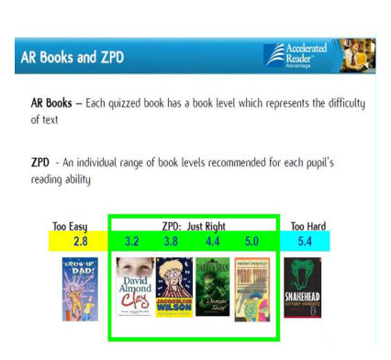

Slide 14
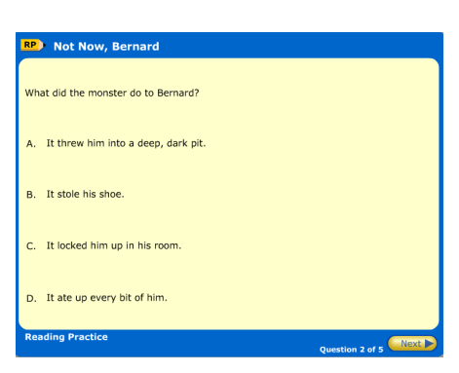
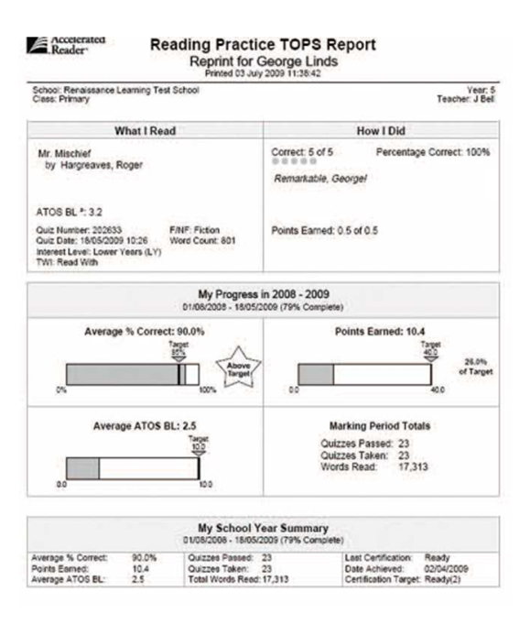

Slide 15
e-Safety
Key Advice for Parents/Carers
Talk to your child and understand how they are using the internet and their phone
Use safety tools and parental controls – if you’re not sure how contact your service provider:
- Please note tools are not always 100% effective
Facebook and Instagram– Accounts for over 13s only.
Your child is just as likely to be a bully as to be a target. Be alert to your child being upset after using the internet/phones – they may be secretive, change relationships with friends
Remind your child not to retaliate
Keep any evidence of Cyberbullying – emails, online conversations, texts etc to show the school/police etc
Report the Cyberbullying:
  – Contact the school so they can take action if it involves another pupil
  – Contact the service provider
  – If the Cyberbullying is serious and a potential criminal offence has been committed then consider contacting the police

Slide 16
SMART rules
SAFE - Staying safe involves being careful and not giving out your name, address, mobile phone number, school name or password to people online.
MEETING someone you have contacted in cyberspace can be dangerous. Only do so with your parent's/carer's permission, and then when they can be present.
ACCEPTING e-mails or opening files from people you don't really know or trust can get you into trouble - they may contain viruses or nasty messages.
RELIABLE - Someone online maybe lying about who they are, and information you find on the Internet may not be reliable.
TELL your parent or carer if someone or something makes you feel uncomfortable or worried.

Slide 17
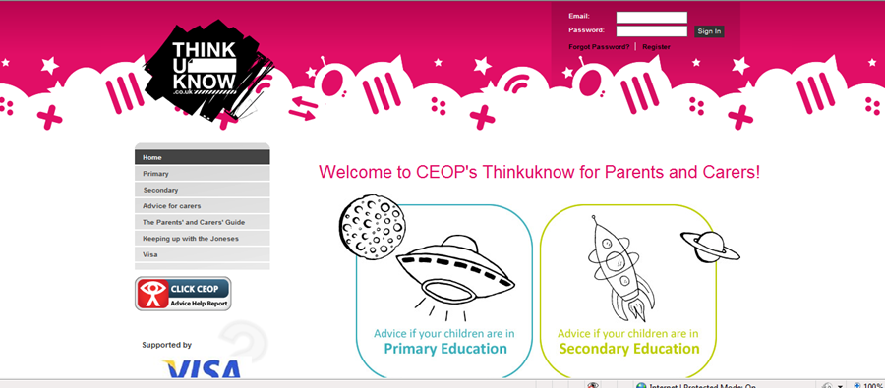
Parents Resource www.thinkuknow.co.uk/parents

Slide 18
Homework
In Year 6 it may be necessary for us to give separate pieces of homework, especially closer to SATS.
Maths - Manga High task once weekly
Reading at least 3x per week aloud to an adult
Regular times tables practise: try http://www.multiplication.com/games/all-games
Home learning projects – Due on the last week of term. See termly letter/homework.

Slide 19
Year 6: Transfer to secondary school
12th October 2017
Kent Test assessment decisions sent to parents (to arrive 13th October)
31st October 2017
Closing date for submitting secondary school applications. Parents are actively encouraged to apply online at www.kent.gov.uk/ola
1st March 2018
Offer of school places will be sent out, via email after 4pm or by 1st class post
5th March 2018
Secondary schools to send out welcome letters to parents
parents must confirm whether or not they accept the offer

Slide 20
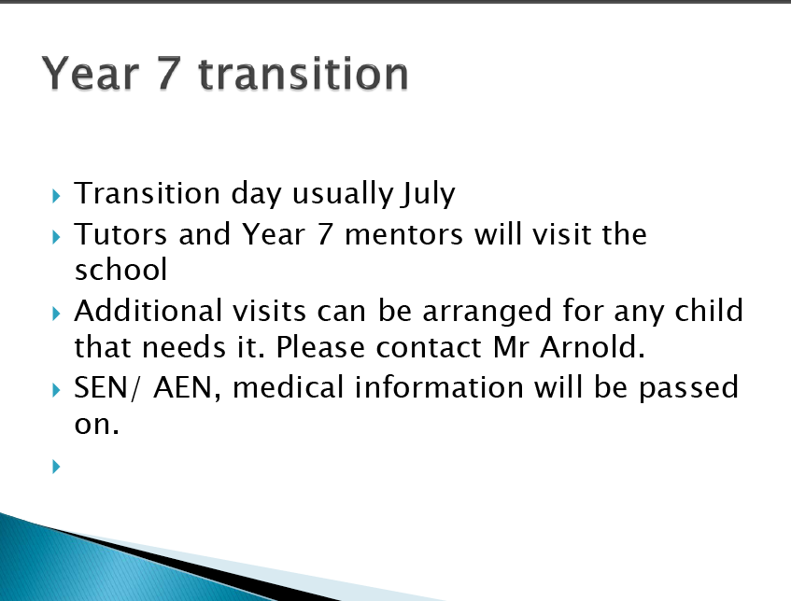
Year 7 transition
Transition day – often first week of July.
Mr Arnold

Slide 21
Year 6 SATs
English: Reading; Grammar, punctuation and Spelling (GPS)
Maths: 2 Reasoning papers, one arithmetic paper (36 questions in 30 minutes)
Writing levels are assessed by teachers using evidence in books – moderated by LEA officials
Date: week beginning 14th May 2018
We track reading & spelling ages, maths, science and writing through in-year assessments

Slide 23
Questions from the 2017 GPS paper

Slide 24
Questions from the 2017 Reading paper

Slide 25
Questions from the 2017 Maths Arithmetic paper (Paper 1)

Slide 26
A question from the 2017 Reasoning Paper 2

Slide 27
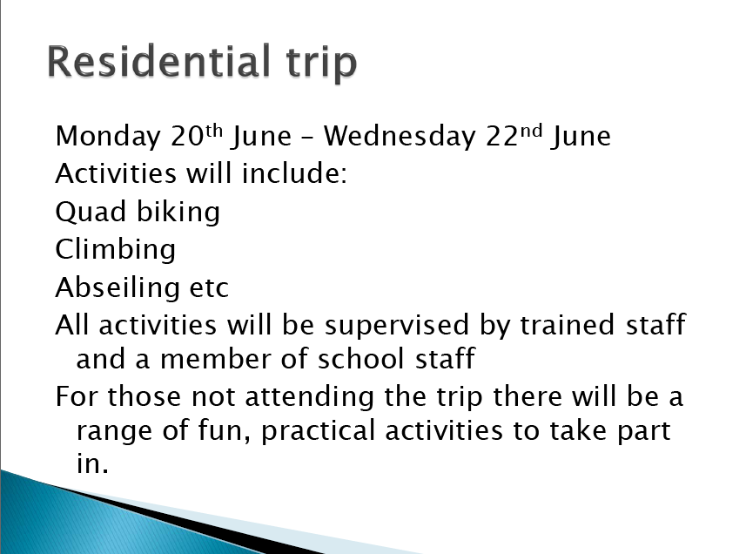
Residential trip
Wednesday 23rd May – Friday 25th May
Activities may include:
Climbing
Zip wire
Problem solving …and many more
NOTE: Long sleeved tops will be required

Slide 28
Extended school...
Breakfast Club 7.45-8.45am £2.50 per day
Coffee mornings: 29th Sept, 23rd Nov, 15th Dec
You will need to register in the office
Family passport activities will continue during the holidays this year.
Activities so far have included Beach Hut days, Day trip to Brighton, Environmental day, Science days and many more
Please see Mrs Hearn or Mrs Biggs for more
information

Slide 29
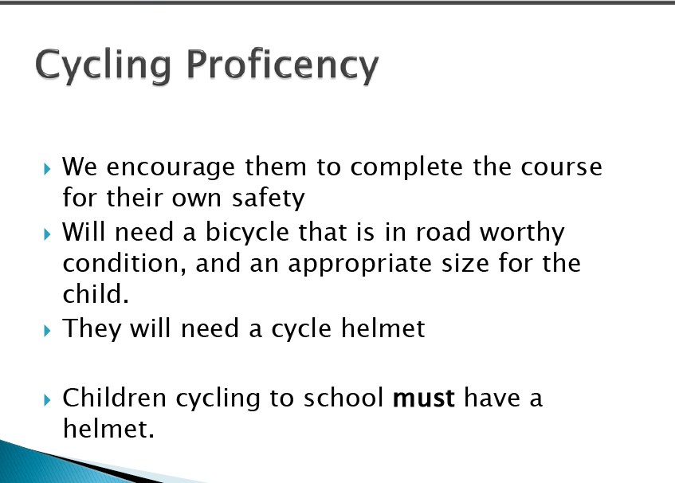
Cycling Proficency
Cycling Proficiency
Your child MUST be able to ride a bicycle competently

Slide 30
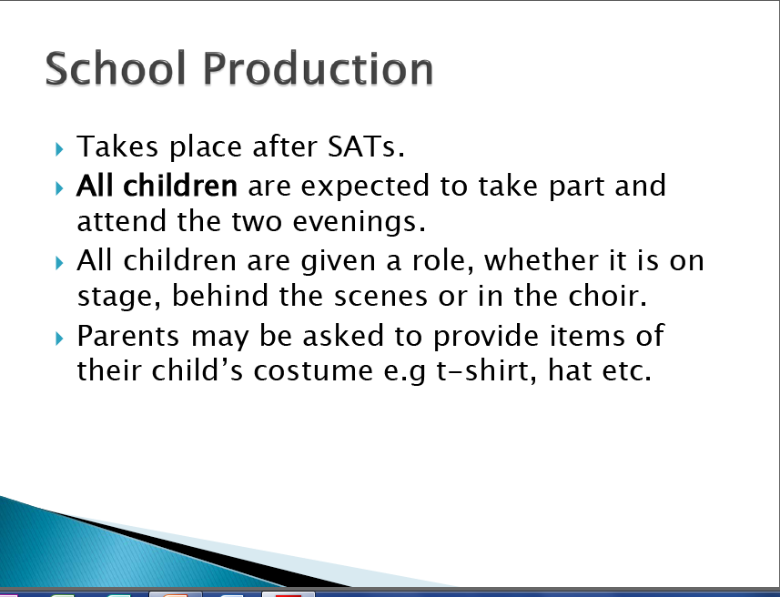
Sex and relationships
Behaviour and attitude to learning throughout
the year will be taken into account when
allocating parts

Slide 31
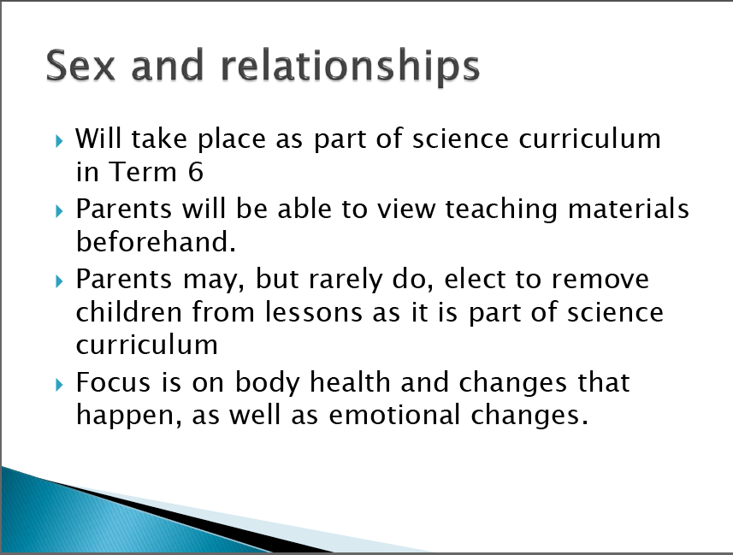
School Production

Slide 32
Website
www.stsavioursjunior.com
Term dates (don’t refer to KCC website as they don’t include training days)
Calendar
Uniform
Christian Values, British Values, Core Values

Slide 33
If you have concerns...
Generally concerns should be raised in this
order...
Class or set teacher
Year group leader (Mrs Gray)
Mr Arnold
Mr Bonell

Slide 34
And finally...
We don’t always get it right...but we never,
ever set out to get it wrong ‘cos that just
would just be plain silly!

