Slide 1
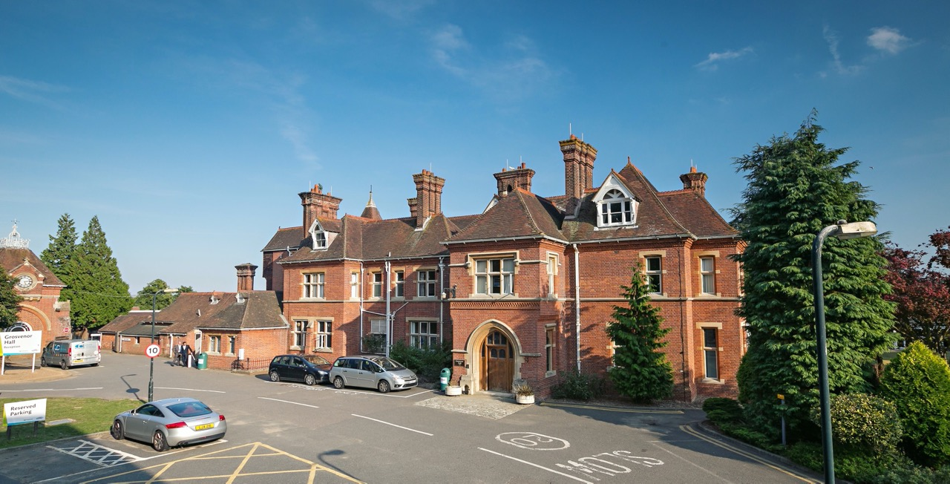
Kingswood Residential Trip
Wed 26th – Thurs 27th June
Information for Parents and carers

Slide 2
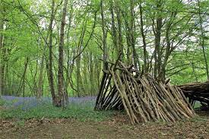
Departure and Arrival
Children arrive at school in their own clothes (at normal school time and will go straight to the hall with bags)
Depart St. Saviour’s Wednesday 26th June 10am
Arrive at Kingswood Centre around 2 pm
Stop for picnic lunch on the way at Betteshanger –fun and games
Depart Kingswood Centre Thursday 27th June by 2pm
Arrive back at St. Saviour’s 3.00pm depending on traffic
All times are subject to traffic, changes will be posted on school notice board / text.

Slide 3
Staffing
Mrs Tift – lead teacher
Miss Cook
Mr Stevens
Miss Drummond
Mrs Theobald-Grainger

Slide 4
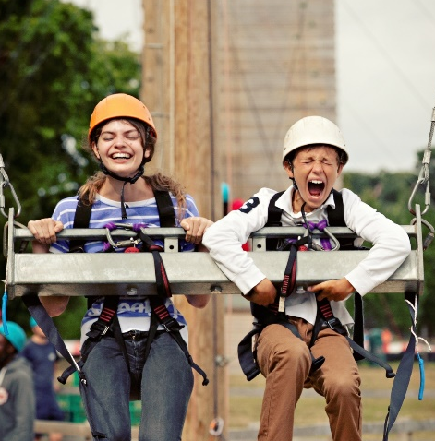
Groupings
Children will choose friendship pairs
Pairs will stay together whenever possible
– bedrooms and activity groups
Bedroom sizes can range from 2 – 12 children in a dormitory style
Any changes will be discussed with the children before we finalise groups

Slide 5

Medical and Dietary Information
All medication needs to be clearly labelled with child’s full name and instructions.
All medication is securely stored and is given, under supervision, by one member of staff.
Asthma pumps MUST be kept by children and carried with them
Dietary requirements form

Slide 6
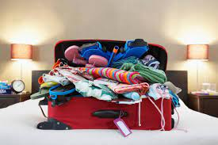
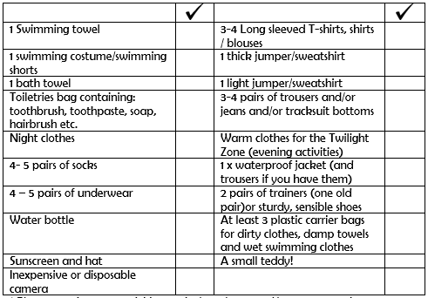
Packing List

Slide 7
Packing
Pack for hot, cold and wet weather.
Long trousers and sleeves required for most activities for extra protection.
Cheap rather than fashionable, children get dirty!
Pack extra changes of clothes as most activities continue in wet weather.
Swimming costume and towel needed
Two pairs of trainers – they are likely to
get muddy
Packed lunch will be required for the first
day – do not pack in suitcase
Carrier bags for dirty or damp clothing

Slide 8

Pocket Money
Maximum of £10
There is very little to spend money on. There is a small gift shop.
The range of souvenirs is limited, unless you like tea towels, paper weights and Haribo!
Pocket money- better in coins than in notes, they are harder to lose.
Place money in a labelled purse, bag or wallet
All money will be the responsibility of the children – not the staff

Slide 9

What not to bring!
These items will be confiscated
Mobile phones (they make children feel homesick and cause a lot of problems)
Electronic games
Spray deodorant
Hair straighteners (there are no plug sockets in bedrooms)
Sweets / food in luggage / fizzy drinks (there is a tuck shop on site and vending machines)
Make-up and cosmetics

Slide 10
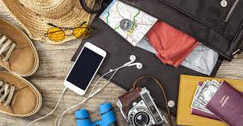
Valuables
Do not allow your child to bring valuables:
Ipods
Expensive cameras
Jewellery
ANY ITEMS WILL BE THE CHILDREN’S
RESPONSIBILITY
Children will not have enough time to use gadgets
Staff cannot guarantee the safety of valuables
Bring cheap disposable camera

Slide 11
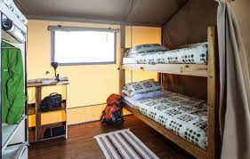
Accommodation
Dormitories with bunk beds (usually)
Rooms are organised so that boys and girls rooms are separated
Shared shower rooms / toilets (end of corridor or attached to each bedroom)
As far as possible, children will be allocated rooms with friendship groups
Staff available all day and night
Kingswood staff give fire safety information and do a fire drill

Slide 12

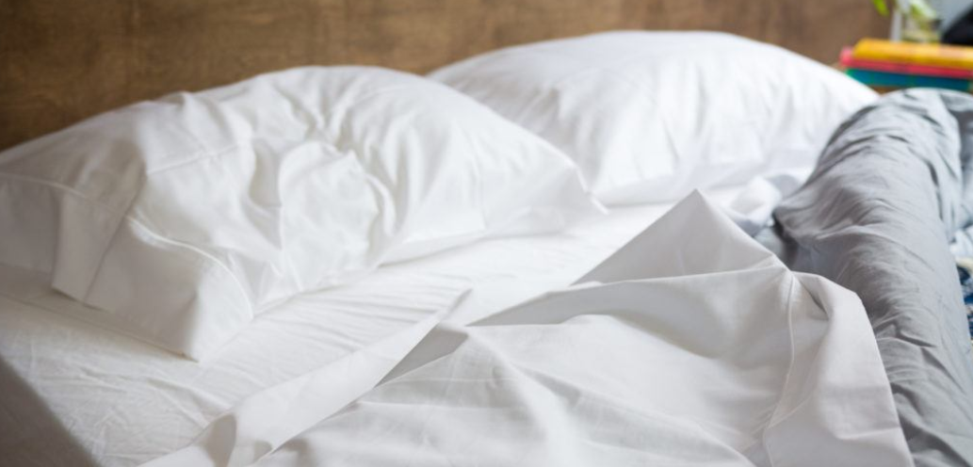
Life Skills!
Children WILL have to make their own beds!

Slide 13
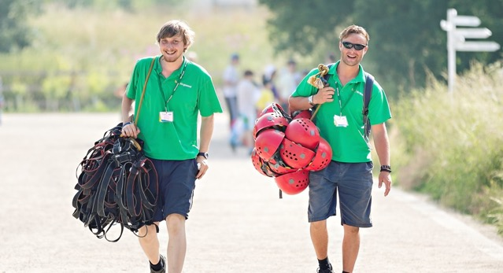
Supervision
Children are supervised in small groups during activities. One or more member of Kingswood staff as well as a member of St. Saviour’s staff.
School staff are responsible for discipline, pastoral care and welfare.
School staff supervise bed times and are on hand 24 hours.
Staff bedrooms are next to
dormitories so children are
supervised at night.

Slide 14
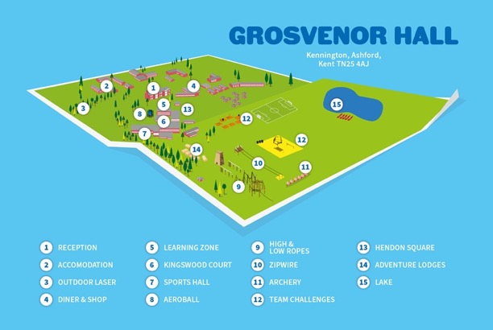
Site Security and Safety
The Grosvenor Hall site is fenced with key pad / staffed entry and exit – NOT open to the public in any way.
There are often other schools on the same site but all contact is supervised.
Evening activities are supervised and members of school staff are always present
All staff CRB checked
All risk assessments
completed

Slide 15
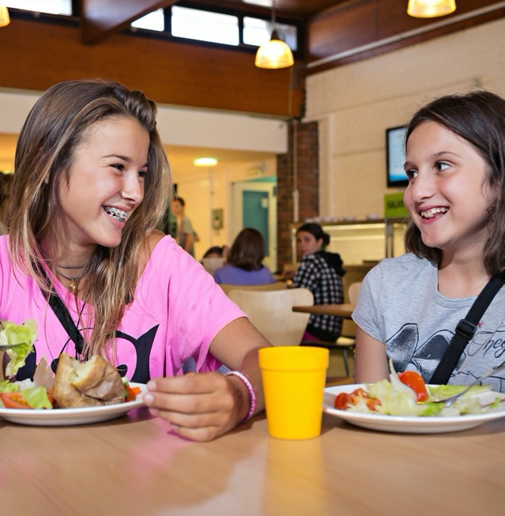
Food
3 meals are provided for ALL children
High quality, varied menu available
Vegans, nut/dairy/egg allergy, gluten
free etc all catered for – colour coded so children do not get mixed up
Range of hot meals available
Salad bar available
Children are encouraged to eat as much as they can
It is not possible for children to bring their own food.
Parents always worry but we have never had a child starve!

Slide 16
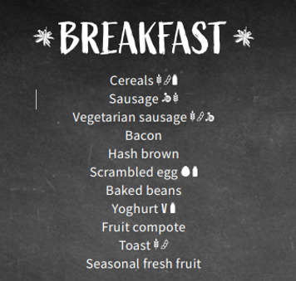
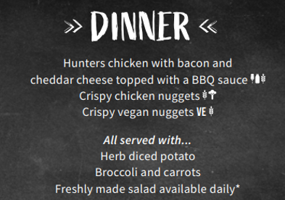
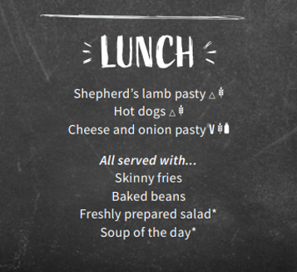
Food – Sample Menu

Slide 17
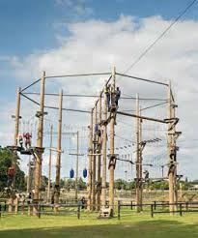
The Plan
Arrive on site at around 2pm
Introduction by course director and tour
Two afternoon activities
Dinner
Evening activities – finish at 9pm
Lights out at 10pm
Wake up – shower, tidy bedrooms
Breakfast – choice of hot or cold food
Activities start at 9:15am - two different activities during the morning
Lunch
Depart site after eating lunch

Slide 18
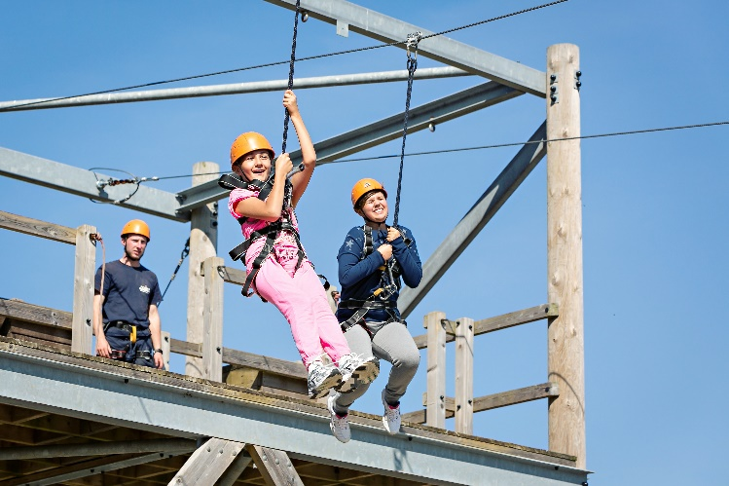
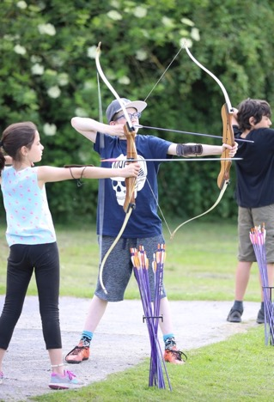
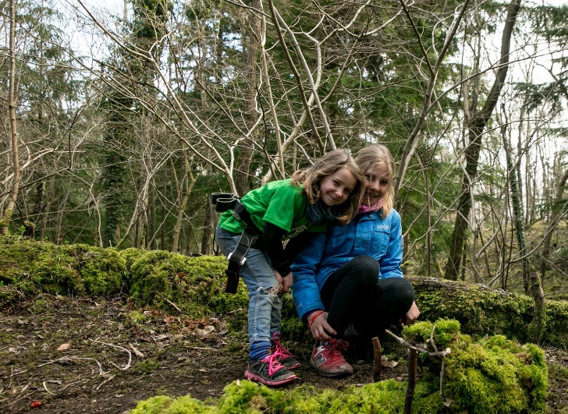
Activities
Full range of adventurous activities:
Zip Wire Archery
Buggy Build

Slide 19
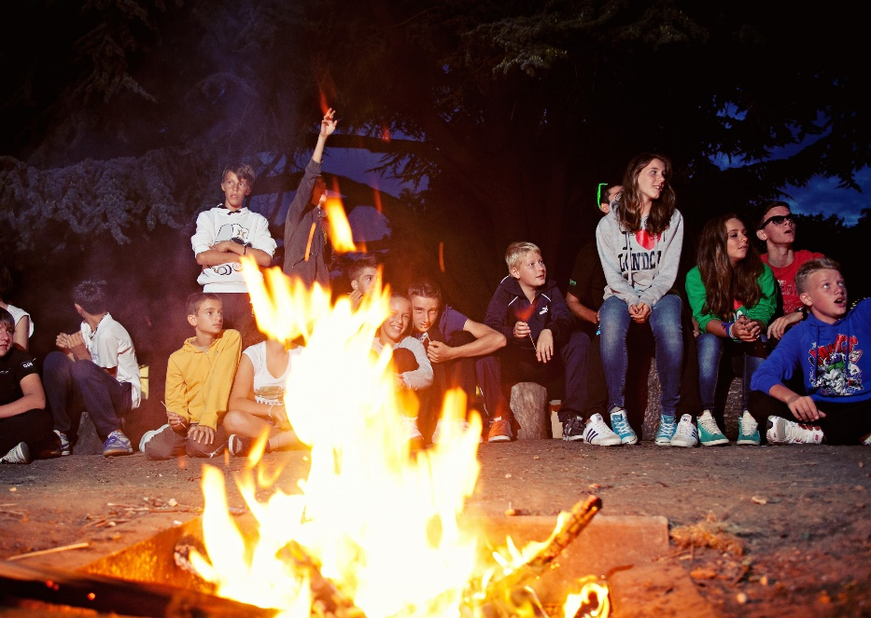
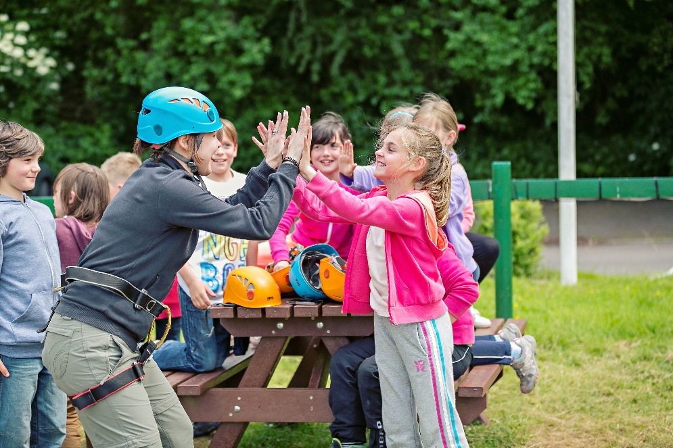
Activities
Campfire Team Games

Slide 20
Contacts
In the unlikely event you need to contact your child, this will be done through the school office who will contact school staff.
Please, please, please do not allow your child to take their mobile telephone. In our experience this makes it harder for children to adjust to being away from family. Telephones also get lost or easily damaged and would be a real safeguarding concern (44 children 5 staff!)
A telephone call from home often makes children more home sick
A very small number of children get home sick in the evening – lots of emotional support / pastoral care given.
Your children will be too busy / tired to be homesick!
School staff only have time to pass on important or emergency information.

Slide 21



