Slide 1

Year 6 SATs 2025 Presentation for Parents, Carers & Guardians
Miss Hayes
Head of Year 6

Slide 2

What will we cover in this meeting?
What are the SATs?
When are the SATs?
Access arrangements.
What do the questions look like?
How can you help your child?
Breakfast club

Slide 3
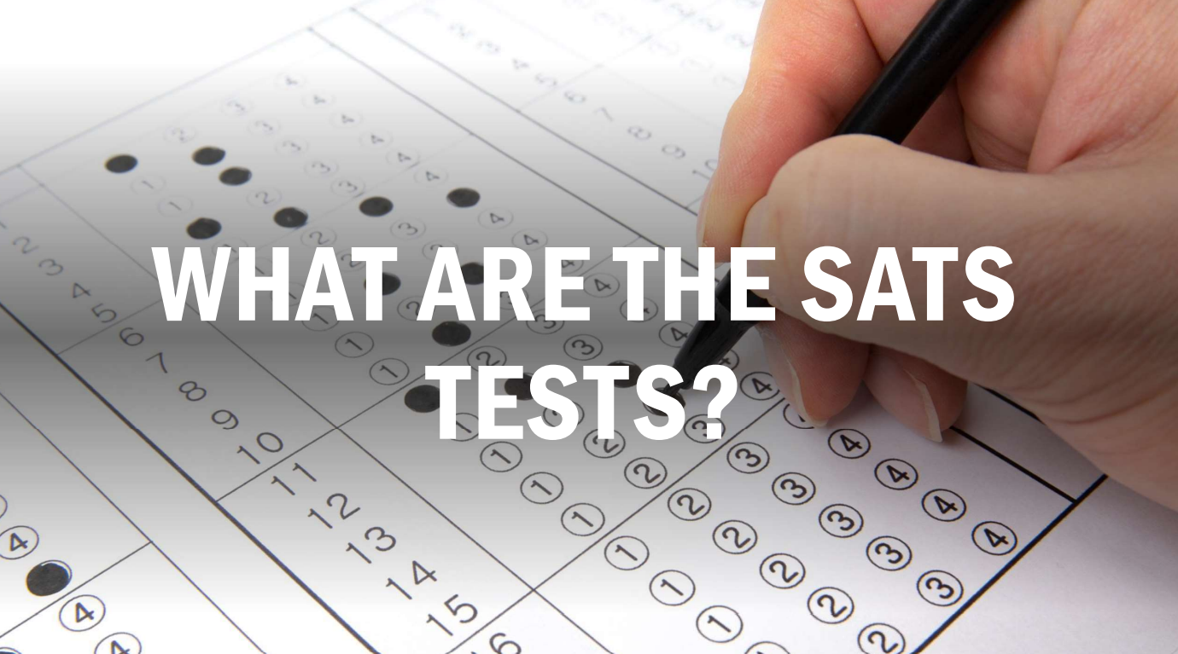

Slide 4
What are the SATs?
SATs are the Standardised Assessment Tests that are given to children at the end of Key Stage 2.
It is a statutory requirement for year 6 pupils in state primary schools across the country to do the SATs.
The aim of the tests is to establish whether pupils are working at an expected level in English and maths for the end of primary school and the start of secondary school.

Slide 5


Slide 6

When are the SATs?
The SATs take place over four days, starting on Monday 12th May ending on Thursday 15th May.
The SATs papers consist of:
  Grammar, punctuation and spelling (paper 1: GPS) – Monday 12th May
  Grammar, punctuation and spelling (paper 2: Spelling) – Monday 12th May
  Reading – Tuesday 13th May
  Maths (paper 1: Arithmetic) – Wednesday 14th May
  Maths (paper 2: Reasoning) – Wednesday 14th May
  Maths (paper 3: Reasoning) – Thursday 15th May
Writing is assessed using evidence collected throughout Year 6. There is no Year 6 SATs writing test.

Slide 7


Slide 8
How the SATs are completed?
The tests take place during normal school hours, under exam conditions.
Children are not allowed to talk to each other from the moment the assessments are handed out until they are collected at the end of the test.
Children have been organised into different rooms based on access arrangements and where we feel they will feel most comfortable. We will be using four classrooms and the hall.
We have completed a mock week so that the children could become familiar with this arrangement.

Slide 9
How the SATs are completed?
Each test lasts no longer than 60 minutes:
  Spelling, punctuation and grammar (paper 1: Grammar/ Punctuation) – 45 minutes
  Spelling, punctuation and grammar (paper 2: Spelling) – 15 minutes
  Reading – 60 minutes
  Maths (paper 1: Arithmetic) – 30 minutes
  Maths (paper 2: Reasoning) – 40 minutes
  Maths (paper 3: Reasoning) – 40 minutes
After the tests are completed, the papers are sent away to be marked externally.
The results, which will be reported as a scaled score from 80 – 120, are then sent to the school in July and will be shared in the end of year school reports.

Slide 10


Slide 11
Specific arrangements for SATs
Access arrangements available to pupils include:
Additional (extra) time;
An adult to scribe (write) for them;
An adult to read for them;
The use of prompters or rest breaks;
Taking the tests in smaller rooms;
Transcription after the test;
Arrangements for children who are ill or injured at the time of the tests.
Pupils with an EHCP are automatically allowed up to 25% additional time (except for the spelling paper, which is not strictly timed).

Slide 12
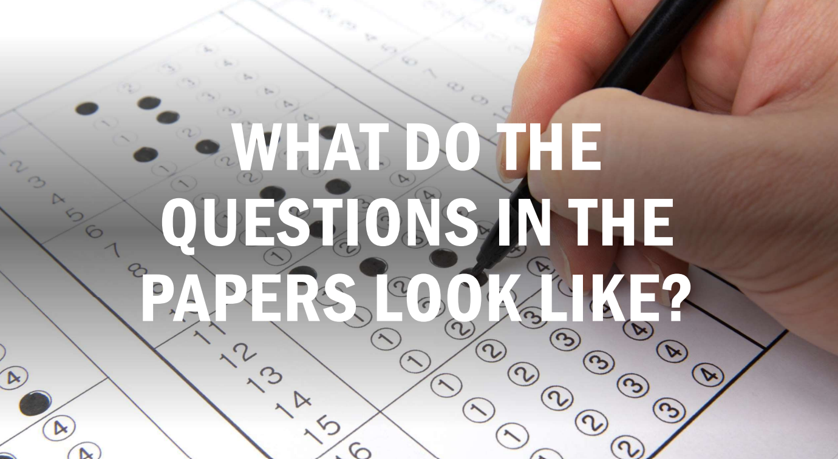

Slide 13
Grammar, Punctuation and Spelling: Monday 12th May
Grammar, punctuation and spelling consists of two papers.
Paper 1: questions (45 minutes) 50 marks
A combined question and answer booklet which assesses pupils’ understanding of the grammar, punctuation and spelling elements of the national curriculum English programmes of study for key stage 2.
Paper 2: spelling (15 minutes but not strictly timed) 20 marks
The paper that pupils receive has 20 sentences, each with a missing word. The teacher reads the sentences one at a time and pupils write in the missing word on their paper.

Slide 14
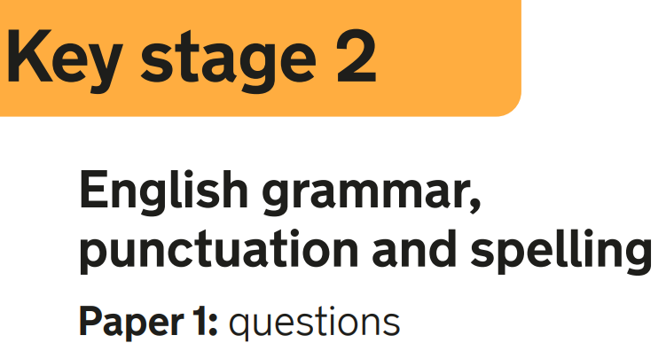
Grammar, Punctuation and Spelling: Paper 1 (GPS)
The children will have been working hard with their class teacher on developing and securing their knowledge of the technical vocabulary needed in this test.
This test focuses on:
Grammatical terms/ word classes;
Functions of sentences;
Combining words, phrases and clauses;
Verb forms, tenses and consistency;
Punctuation;
Vocabulary;
Standard English and formality.
This test requires a range of answer types but does not require longer formal answers.
Notes:
The question types include:
Circling
Drawing lines to connect
Multiple choice questions (including ticking tables)
One-word answers
Short answer questions

Slide 15



Grammar, Punctuation and Spelling: Paper 1 (GPS)
Example questions:
e.g. Although, while
✓
✓
e.g. Although, while
e.g. Over two thousand years ago, Britain was invaded by the Romans.
e.g. Over two thousand years ago, Britain was invaded by the Romans.
Previous papers are available to look through at the end.

Slide 16
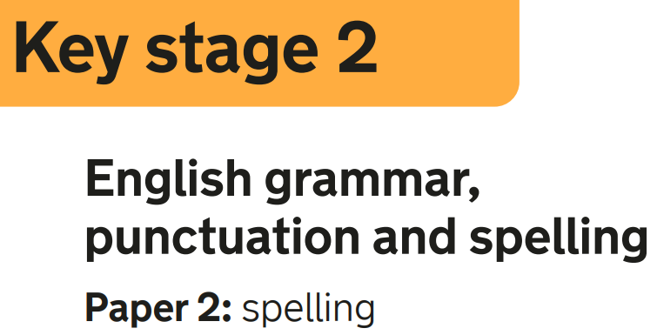


Grammar, Punctuation and Spelling: Paper 2 (spelling)
Paper 2 is a shorter paper that focuses solely on spellings.
Example questions:

Slide 17
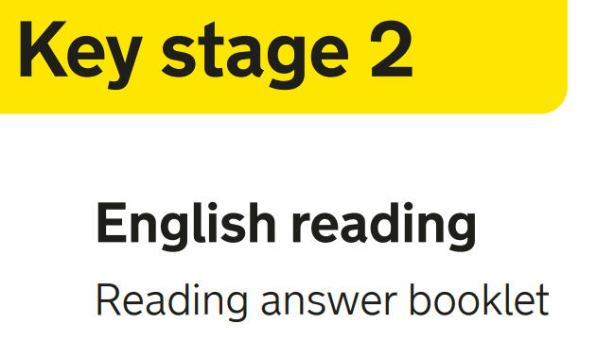

Reading: Tuesday 13th May
There is one reading test that lasts for 60 minutes.
The test is designed to measure if the children’s comprehension of age-appropriate reading material meets the national standard. There are three different set texts for children to read. These could be any combination of non-fiction, fiction and/ or poetry.
The test covers the following areas (known as Content Domains):
Give/ explain the meaning of words in context;
Retrieve and record information/ identify key details from fiction and non-fiction;
Summarise main ideas from more than one paragraph;
Make inferences from the text/ explain and justify inferences with evidence from the text;
Predict what might happen from details stated and implied;
Identify/ explain how information/ narrative content is related and contributes to meaning as a whole;
Identify/ explain how meaning is enhanced through choice of words and phrases;
Make comparisons within the text.

Slide 18



Reading
The reading SATs paper requires a range of answer styles.
Example questions:
Previous papers are available to look through at the end.

Slide 19


Reading
The reading SATs paper requires a range of answer styles.
Example questions:

Slide 20


Reading
Example questions:
3 mark question

Slide 21
Maths: Wednesday 14th May and Thursday 15th May
The maths assessments consist of three tests.
Paper 1: Arithmetic (30 minutes) – Wednesday 14th May
Paper 2: Reasoning (40 minutes) – Wednesday 14th May
Paper 3: Reasoning (40 minutes) – Thursday 15th May

Slide 22
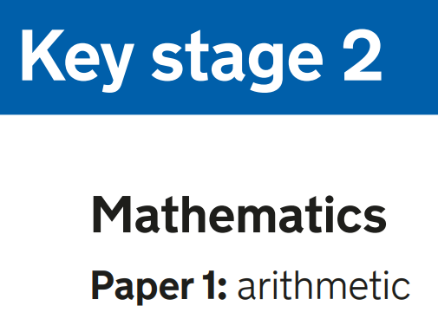


Maths: Paper 1 (Arithmetic)
The maths arithmetic paper has a total of 40 marks and lasts for 30 minutes.
The test covers the four operations (addition, subtraction, multiplication, division, including order of operations requiring BIDMAS), percentages of amounts and calculating with decimals and fractions.
Example questions:
Previous papers are available to look through at the end.

Slide 23






Maths: Paper 1 (Arithmetic)
6
7.800
+ 6.958.
14.758
¹
Mental method:
Count on from 795 to 801
14.758
$\frac{\text{5}}{\text{8}}$ = $\frac{\text{10}}{\text{16}}$
$\frac{\text{10}}{\text{16}}$ + $\frac{\text{3}}{\text{16}}$ = $\frac{\text{1}\text{3}}{\text{16}}$
48 ÷ 6 = 8
70 + 8 = 78
$$\frac{\text{1}\text{3}}{\text{16}}$$
78

Slide 24
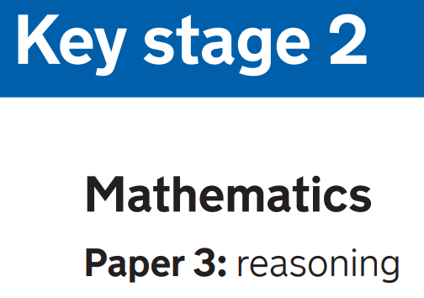
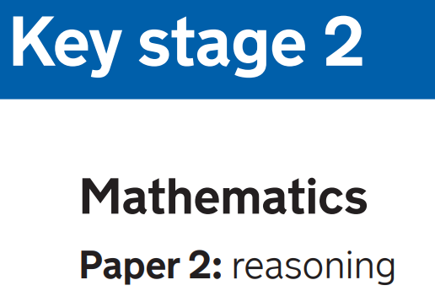
Maths: Paper 2 and 3 (Reasoning)
Paper 2 will take place on Wednesday 14th May and paper 3 will take place on Thursday 15th May. These tests have a total of 35 marks each and lasts for 40 minutes each.
These papers require children to demonstrate their mathematical knowledge and skills, as well as their ability to solve problems and their mathematical reasoning. They cover a wide range of mathematical topics from key stage 2 including,
Number and place value (including Roman numerals);
The four operations;
Geometry (properties of shape, position and direction);
Statistics;
Measurement (length, perimeter, mass, volume, time, money);
Algebra;
Ratio and proportion;
Fractions, decimals and percentages.

Slide 25


Maths: Paper 2 and 3 (Reasoning)
Example questions:
24,400
Previous papers are available to look through at the end.
6 2

Slide 26
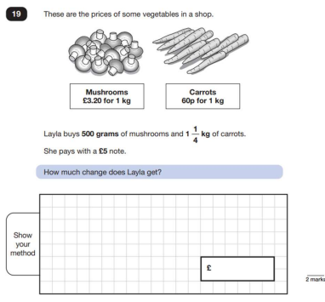
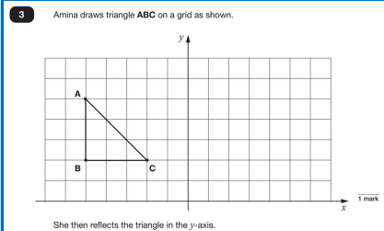
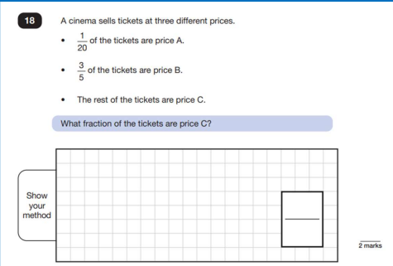
Maths: Paper 2 and 3 (Reasoning)
Previous papers are available to look through at the end.

Slide 27


Maths: Paper 2 and 3 (Reasoning)

Slide 28


Slide 29
Supporting your child in preparing for the SATs
Firstly, a positive attitude goes a long way. Give them as much encouragement and support as you can (but we don’t need to tell you that)!
Tips:
Give your child a quiet, distraction free space to complete homework or study.
Give your child time to go outside and reduce screen time.
Encourage them to keep active on a daily basis – aim for 60 minutes!
Ensure your child is eating and drinking well.
Ensure your child is getting a good amount of sleep – primary children need between 9 – 11 hours of sleep per night.
Help them switch off from technology at least 30 mins- 1 hr before going to sleep.
Encourage your child to talk to their teacher or a trusted adult (including yourself) about their anxieties. Don’t forget that a small amount of anxiety is normal and not harmful.
Plan something nice and fun for the weekends before and after SATs. This will help them to relax before the SATs and give them something to look forward to after.

Slide 30

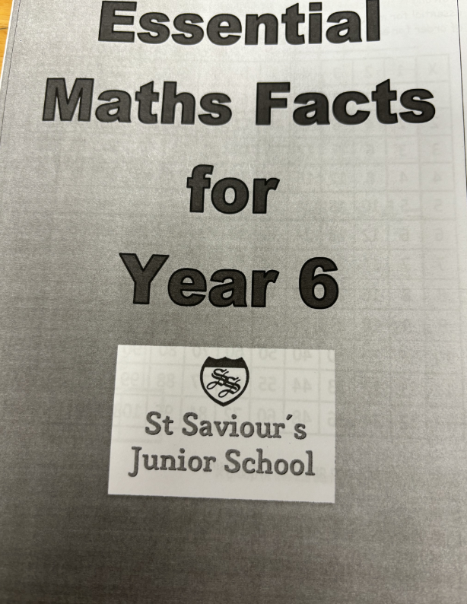
Supporting your child in preparing for the SATs
GPS booklet

Slide 31


Slide 32
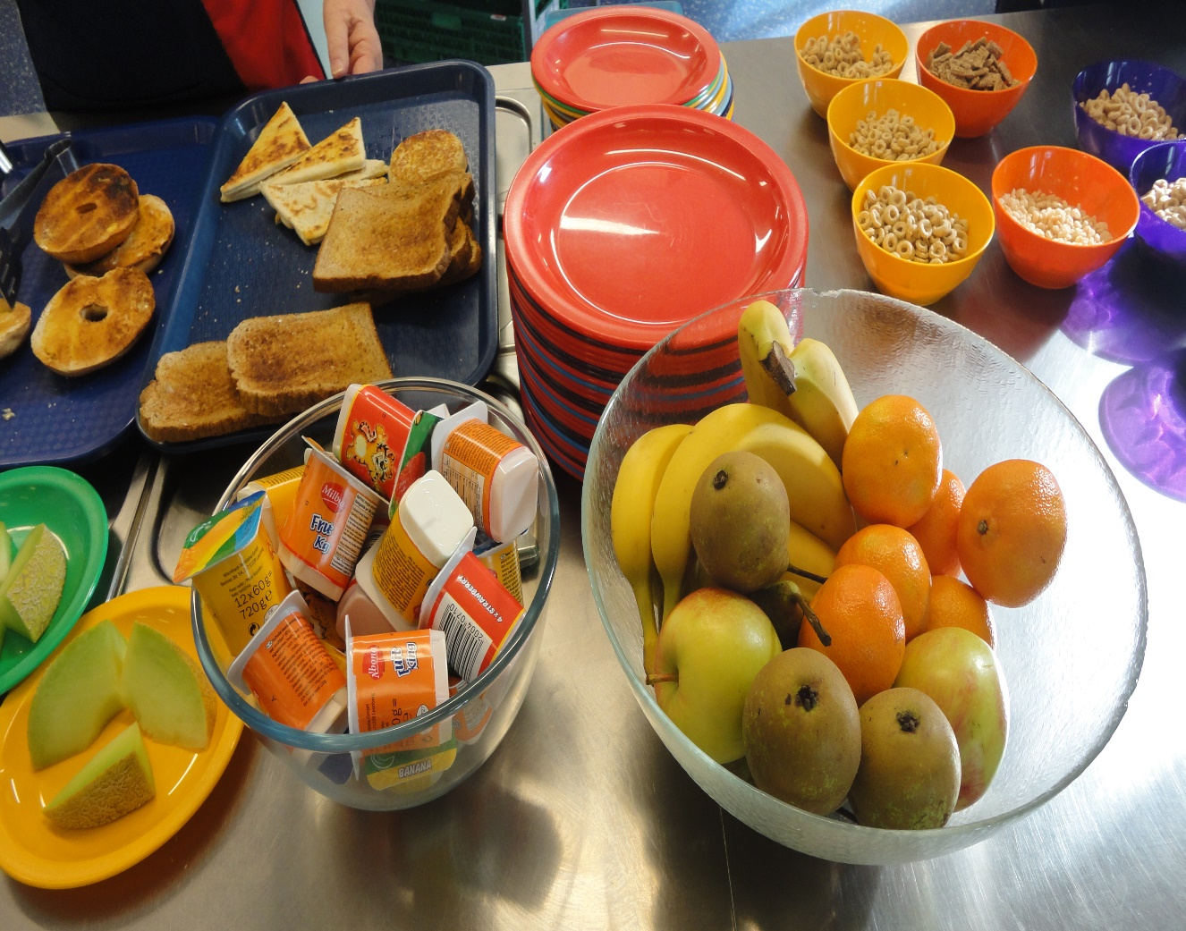
Breakfast club!
Free to all Year 6 children Monday-Thursday during SATs week.
8:15 – 8:40am
Food is included: toast, cereal, yoghurt, fruit, fruit juices
Held in the Year 6 classrooms
Run by Year 6 staff
No need to book – you can simply turn up on the day
Even if you don’t want to eat, everyone is still welcome!
Purpose of breakfast club:
Settle and calm the children
To ensure your child is in school on time
It will help reduce stress levels

Slide 33

Finally…
SATs focus on what children know about Maths and English and don’t tell the whole story.
They will not reflect how talented they are at science, geography, art, PE…, and they certainly won’t highlight all of their amazing personal characteristics.

Slide 34

Any questions?

